Slide 1

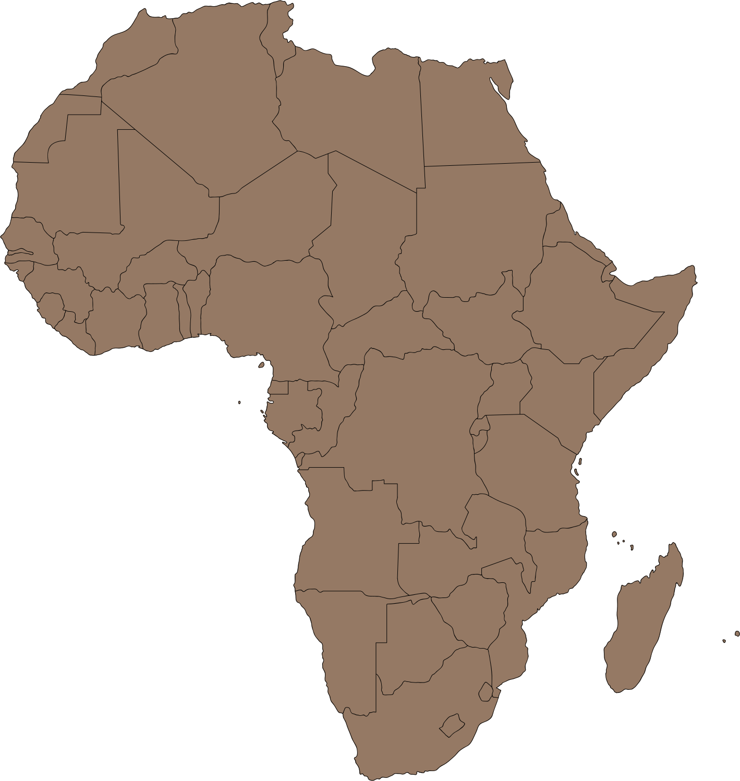

Multi-country analysis of WHO Antenatal Care Policy on the Prevention of Malaria in Pregnancy
Bolanle Olapeju
MD, PhD, MSPH
September 13, 2023

Slide 2

Co-author: Michael Bride, MPH. Johns Hopkins Center for Communications Programs, USA
Disclosure: “No known competing financial interests or personal relationships to disclose”
Disclaimer: “The opinions and assertions expressed herein are those of the author(s) and do not reflect the official policy or position of the Uniformed Services University of the Health Sciences or the Department of Defense.”
Presentation images: All stock photos and images in this presentation were obtained from CANVA and are in keeping with CANVA’s licensing terms and conditions.

Slide 3

Outline
  Reflexivity
  Background
  Methodology
  Results
  Conclusions

Slide 4

REFLEXIVITY
REFLEXIVITY
BACKGROUND
METHODOLOGY
RESULTS
CONCLUSIONS

Slide 5



We Don't See Things As They Are, We See Them As We Are
TALMUD
Perspectives shaped by experiences
REFLEXIVITY
BACKGROUND
METHODOLOGY
RESULTS
CONCLUSIONS

Slide 6

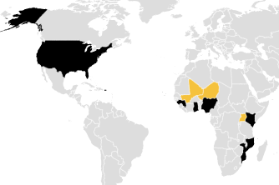

Perspectives shaped by context
REFLEXIVITY
BACKGROUND
METHODOLOGY
RESULTS
CONCLUSIONS

Slide 7




STUDY OBJECTIVE
Explore the relationship between antenatal care (ANC) attendance and intermittent presumptive treatment in pregnancy (IPTp) in sub-Saharan Africa since the rollout of WHO policy in 2016.
Lina Vanessa Merchán Jimenez. Portrait of Pregnant Woman. Retrieved from https://www.canva.com/design/
Lina Vanessa Merchán Jimenez. Portrait of Pregnant Woman. Retrieved from https://www.canva.com/design/
Lina Vanessa Merchán Jimenez. Portrait of Pregnant Woman. Retrieved from https://www.canva.com/design/
Lina Vanessa Merchán Jimenez. Portrait of Pregnant Woman. Retrieved from https://www.canva.com/design/

Slide 8

BACKGROUND
REFLEXIVITY
BACKGROUND
METHODOLOGY
RESULTS
CONCLUSIONS

Slide 9
FOCUSED ANC MODEL | FOCUSED ANC MODEL
1ST TRIMESTER | Contact 1: 8-12 weeks
2ND TRIMESTER | Contact 2: 24-26 weeks
3RD TRIMESTER | Contact 3: 32 weeks Contact 4: 36- 38 weeks
"WHO recommends a schedule of at least four antenatal care visits. IPTp-SP should be delivered at each scheduled ANC visit (except during the first trimester and with doses given at least one month apart), and compliance with antenatal care should be encouraged as much as possible."
WHO policy brief for the implementation of IPTp-SP
2013-14
REFLEXIVITY
BACKGROUND
METHODOLOGY
RESULTS
CONCLUSIONS

Slide 10
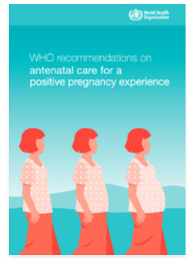

2013
2016
FOCUSED ANC MODEL | FOCUSED ANC MODEL
1ST TRIMESTER | Contact 1: 8-12 weeks
2ND TRIMESTER | Contact 2: 24-26 weeks
3RD TRIMESTER | Contact 3: 32 weeks Contact 4: 36- 38 weeks
  Person-centered care
  Prevent death and disease
  Improve well-being
  Equity and human right
REFLEXIVITY
BACKGROUND
METHODOLOGY
RESULTS
CONCLUSIONS

Slide 11


Implementing Malaria in Pregnancy (MIP) Programs in the
Context of WHO ANC Recommendations
2016 ANC MODEL | 2016 ANC MODEL | Malaria in Pregnancy
1ST TRIMESTER | Contact 1: up to 12 weeks | Provide ITN Counsel on ANC attendance, malaria prevention and treatment
2ND TRIMESTER | Contact 1a: 13-16 weeks | IPTP1
2ND TRIMESTER | Contact 2: 20 weeks Contact 3: 26 weeks | IPTP2 IPTP3
3RD TRIMESTER | Contact 4: 30 weeks Contact 5: 34 weeks Contact 6: 36 weeks Contact 7: 38 weeks Contact 8: 40 weeks | IPTP4 IPTP5 - IPTP6 -
IPTp is safe from second trimester until delivery. Should be given by directly observed treatment. Pregnant women should receive MiP interventions as appropriate, even when they come at weeks not designated in the contact schedule. Side effects should be discussed openly and managed. | IPTp is safe from second trimester until delivery. Should be given by directly observed treatment. Pregnant women should receive MiP interventions as appropriate, even when they come at weeks not designated in the contact schedule. Side effects should be discussed openly and managed. | IPTp is safe from second trimester until delivery. Should be given by directly observed treatment. Pregnant women should receive MiP interventions as appropriate, even when they come at weeks not designated in the contact schedule. Side effects should be discussed openly and managed.
REFLEXIVITY
BACKGROUND
METHODOLOGY
RESULTS
CONCLUSIONS

Slide 12

METHODOLOGY
REFLEXIVITY
BACKGROUND
METHODOLOGY
RESULTS
CONCLUSIONS

Slide 13
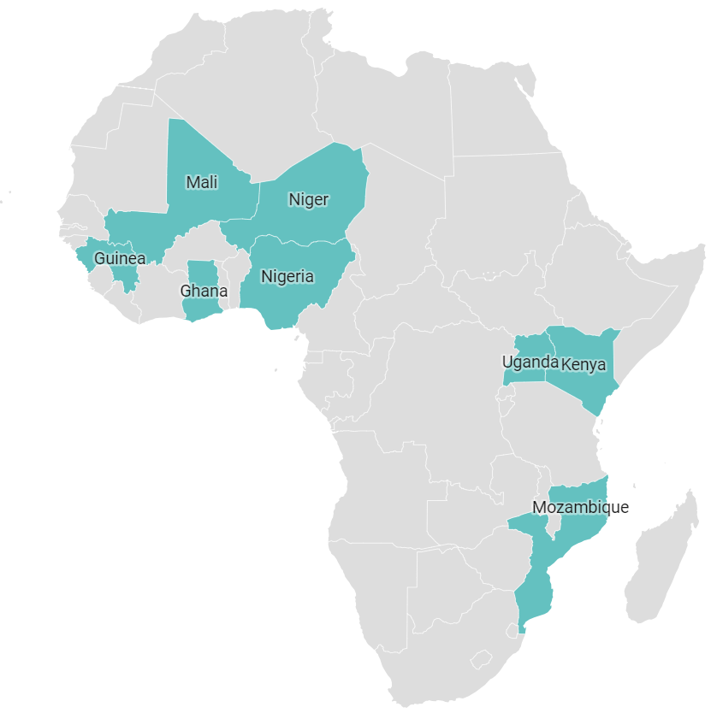
Study Countries
  Sub-Saharan Africa (N=8)
  Recent MIS data
    2018-date
      post 2016 policy
      pregnancy in past 2 years
REFLEXIVITY
BACKGROUND
METHODOLOGY
RESULTS
CONCLUSIONS

Slide 14
Analysis
  DHSProgram STATcompiler
  Cross tabulations
  Country level Correlations
  Multivariable logistic regressions
REFLEXIVITY
BACKGROUND
METHODOLOGY
RESULTS
CONCLUSIONS

Slide 15

RESULTS
REFLEXIVITY
BACKGROUND
METHODOLOGY
RESULTS
CONCLUSIONS

Slide 16
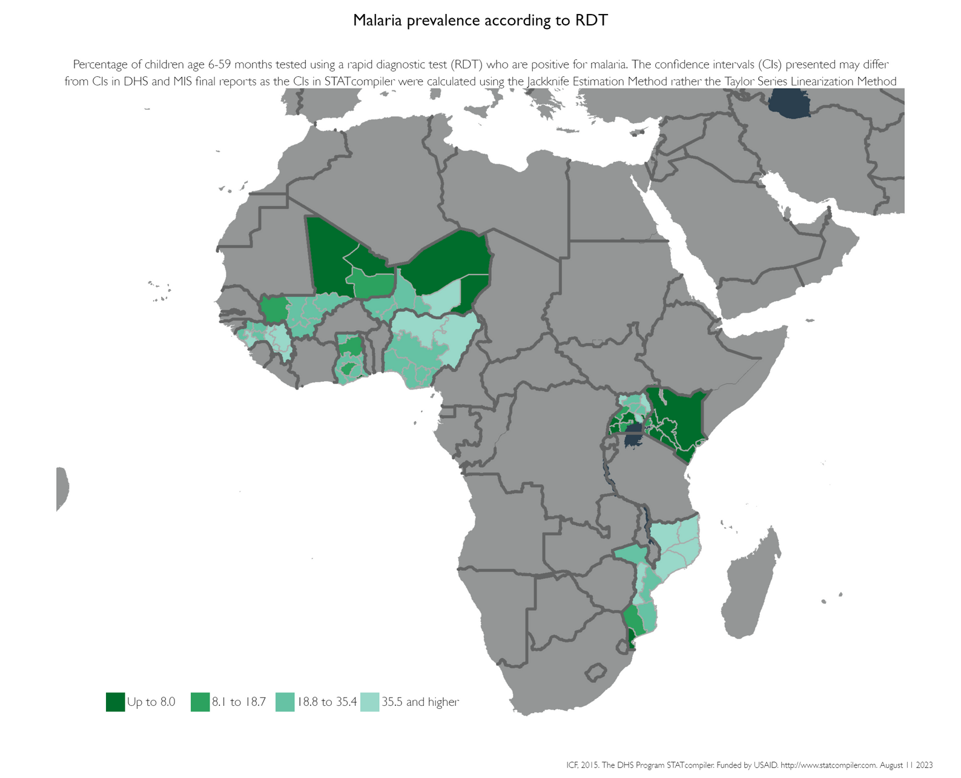

RobertoVi. Smiling Girl Outdoors. Retrieved from https://www.canva.com/design/
Varying U5 RDT Malaria Prevalence
(2018-2021)
REFLEXIVITY
BACKGROUND
METHODOLOGY
RESULTS
CONCLUSIONS

Slide 17

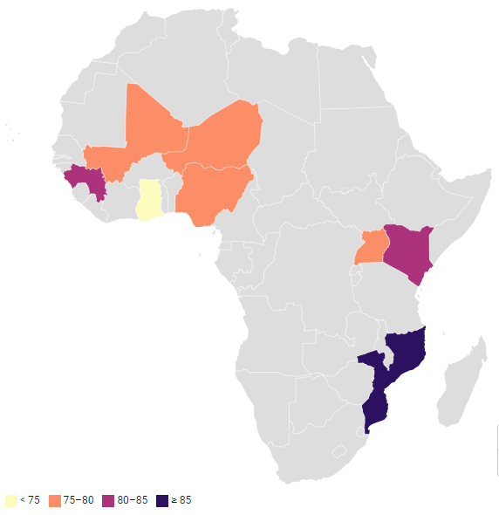
% of mothers <35 years old
Rachel Seidu. Woman in Traditional Clothes. Retrieved from https://www.canva.com/design/
Mostly young mothers
REFLEXIVITY
BACKGROUND
METHODOLOGY
RESULTS
CONCLUSIONS

Slide 18

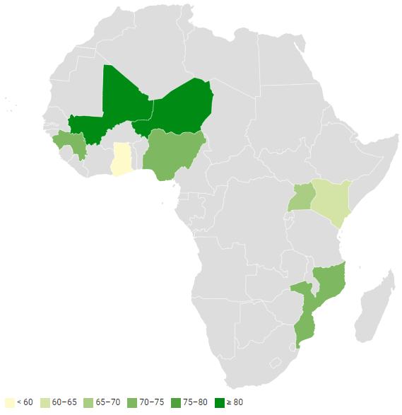
Percent of mothers in rural areas
Jackson David. Photo of Smiling Woman in African Headscarf and Skirt and Black Halter Top Laughing With Her Eyes Closed. Retrieved from https://www.canva.com/design/
Mostly rural residents
REFLEXIVITY
BACKGROUND
METHODOLOGY
RESULTS
CONCLUSIONS

Slide 19

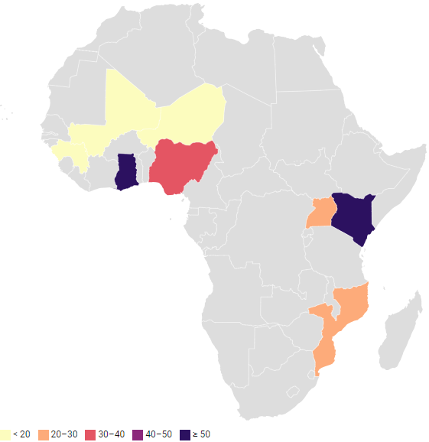
Percent with secondary education
Safari Consoler. African Woman Smiling. Retrieved from https://www.canva.com/design/
Heterogeneity in education
REFLEXIVITY
BACKGROUND
METHODOLOGY
RESULTS
CONCLUSIONS

Slide 20
IPTP3, ANC4 & ANC8
REFLEXIVITY
BACKGROUND
METHODOLOGY
RESULTS
CONCLUSIONS

Slide 21
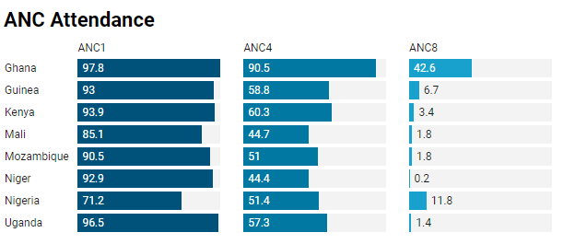
Massive Drop from ANC4 to ANC8
REFLEXIVITY
BACKGROUND
METHODOLOGY
RESULTS
CONCLUSIONS

Slide 22
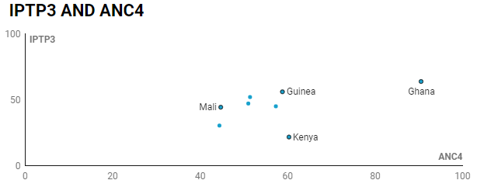
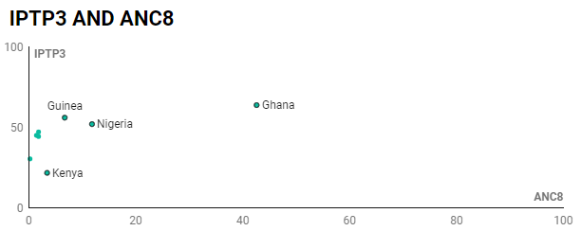
Corr= 0.43
National Correlation between IPTP3 & ANC4 higher than IPTP & ANC8
Corr= 0.35
REFLEXIVITY
BACKGROUND
METHODOLOGY
RESULTS
CONCLUSIONS

Slide 23
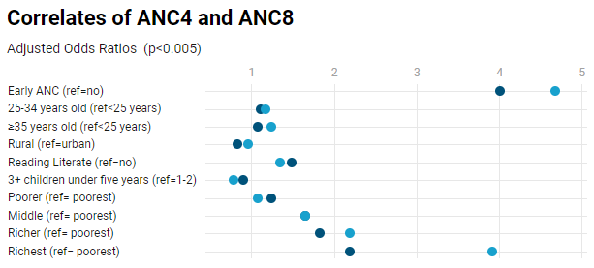
Few notable differences in factors associated with ANC4 and ANC8 across all countries
REFLEXIVITY
BACKGROUND
METHODOLOGY
RESULTS
CONCLUSIONS

Slide 24
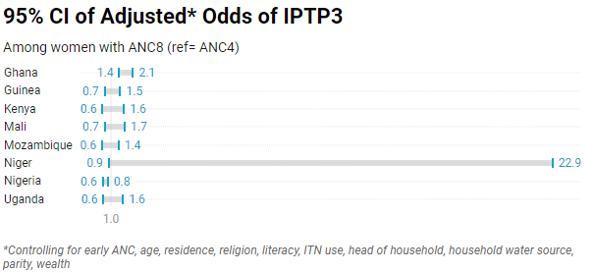
No significant difference in odds of IPTP3 in most countries
REFLEXIVITY
BACKGROUND
METHODOLOGY
RESULTS
CONCLUSIONS

Slide 25

CONCLUSIONS
REFLEXIVITY
BACKGROUND
METHODOLOGY
RESULTS
CONCLUSIONS

Slide 26

  Goldilocks
    Just right
    Feasibility vs aspiration
  Do No Harm
    Address inequity
Policy Implications
REFLEXIVITY
BACKGROUND
METHODOLOGY
RESULTS
CONCLUSIONS

Slide 27
  Policy= implement
    Act now
  Policy=empower
    Resilience
"The best time to plant a tree was 20 years ago. The second best time is now." - Chinese Proverb
Policy Implications
REFLEXIVITY
BACKGROUND
METHODOLOGY
RESULTS
CONCLUSIONS

Slide 28

Improving ANC2+
  Demand
    Social and behavior change
      mHealth
      CHW Education
      Group ANC
  Supply
    Community ANC
    Health system strengthening
Programmatic Implications
REFLEXIVITY
BACKGROUND
METHODOLOGY
RESULTS
CONCLUSIONS

Slide 29

Persisting Gaps in GANC
  Effect on # ANC contacts
  Optimal group size, frequency, and content
  Feasibility, acceptability and cost-effectiveness
Research Implications
REFLEXIVITY
BACKGROUND
METHODOLOGY
RESULTS
CONCLUSIONS

Slide 30

Persisting Gaps in SBC
  Optimal methods for community-based interventions
  How to integrate community-based mobilization efforts with health systems
Research Implications
REFLEXIVITY
BACKGROUND
METHODOLOGY
RESULTS
CONCLUSIONS

Slide 31
Next Steps
Drafting a manuscript
Thank
you!
Interested co-author?
contact me
REFLEXIVITY
BACKGROUND
METHODOLOGY
RESULTS
CONCLUSIONS

Slide 32
Questions and comments?

Slide 33
Extra Slides

Slide 34
2016 ANC MODEL | 2016 ANC MODEL
1ST TRIMESTER | Contact 1: up to 12 weeks
2ND TRIMESTER | Contact 2: 20 weeks Contact 3: 26 weeks
3RD TRIMESTER | Contact 4: 30 weeks Contact 5: 34 weeks Contact 6: 36 weeks Contact 7: 38 weeks Contact 8: 40 weeks
Return for delivery at 41 weeks if not given birth. | Return for delivery at 41 weeks if not given birth.
Note: Intermittent preventive treatment of malaria in pregnancy should be started at ≥ 13 weeks. | Note: Intermittent preventive treatment of malaria in pregnancy should be started at ≥ 13 weeks.
FOCUSED ANC MODEL | FOCUSED ANC MODEL
1ST TRIMESTER | Contact 1: 8-12 weeks
2ND TRIMESTER | Contact 2: 24-26 weeks
3RD TRIMESTER | Contact 3: 32 weeks Contact 4: 36- 38 weeks
  Person-centered care
  Prevent death and disease
  Improve well-being
  Equity and human right
REFLEXIVITY
BACKGROUND
METHODOLOGY
RESULTS
CONCLUSIONS

Slide 35
DESCRIPTION OF STUDY POPULATION
REFLEXIVITY
BACKGROUND
METHODOLOGY
RESULTS
CONCLUSIONS

Slide 36
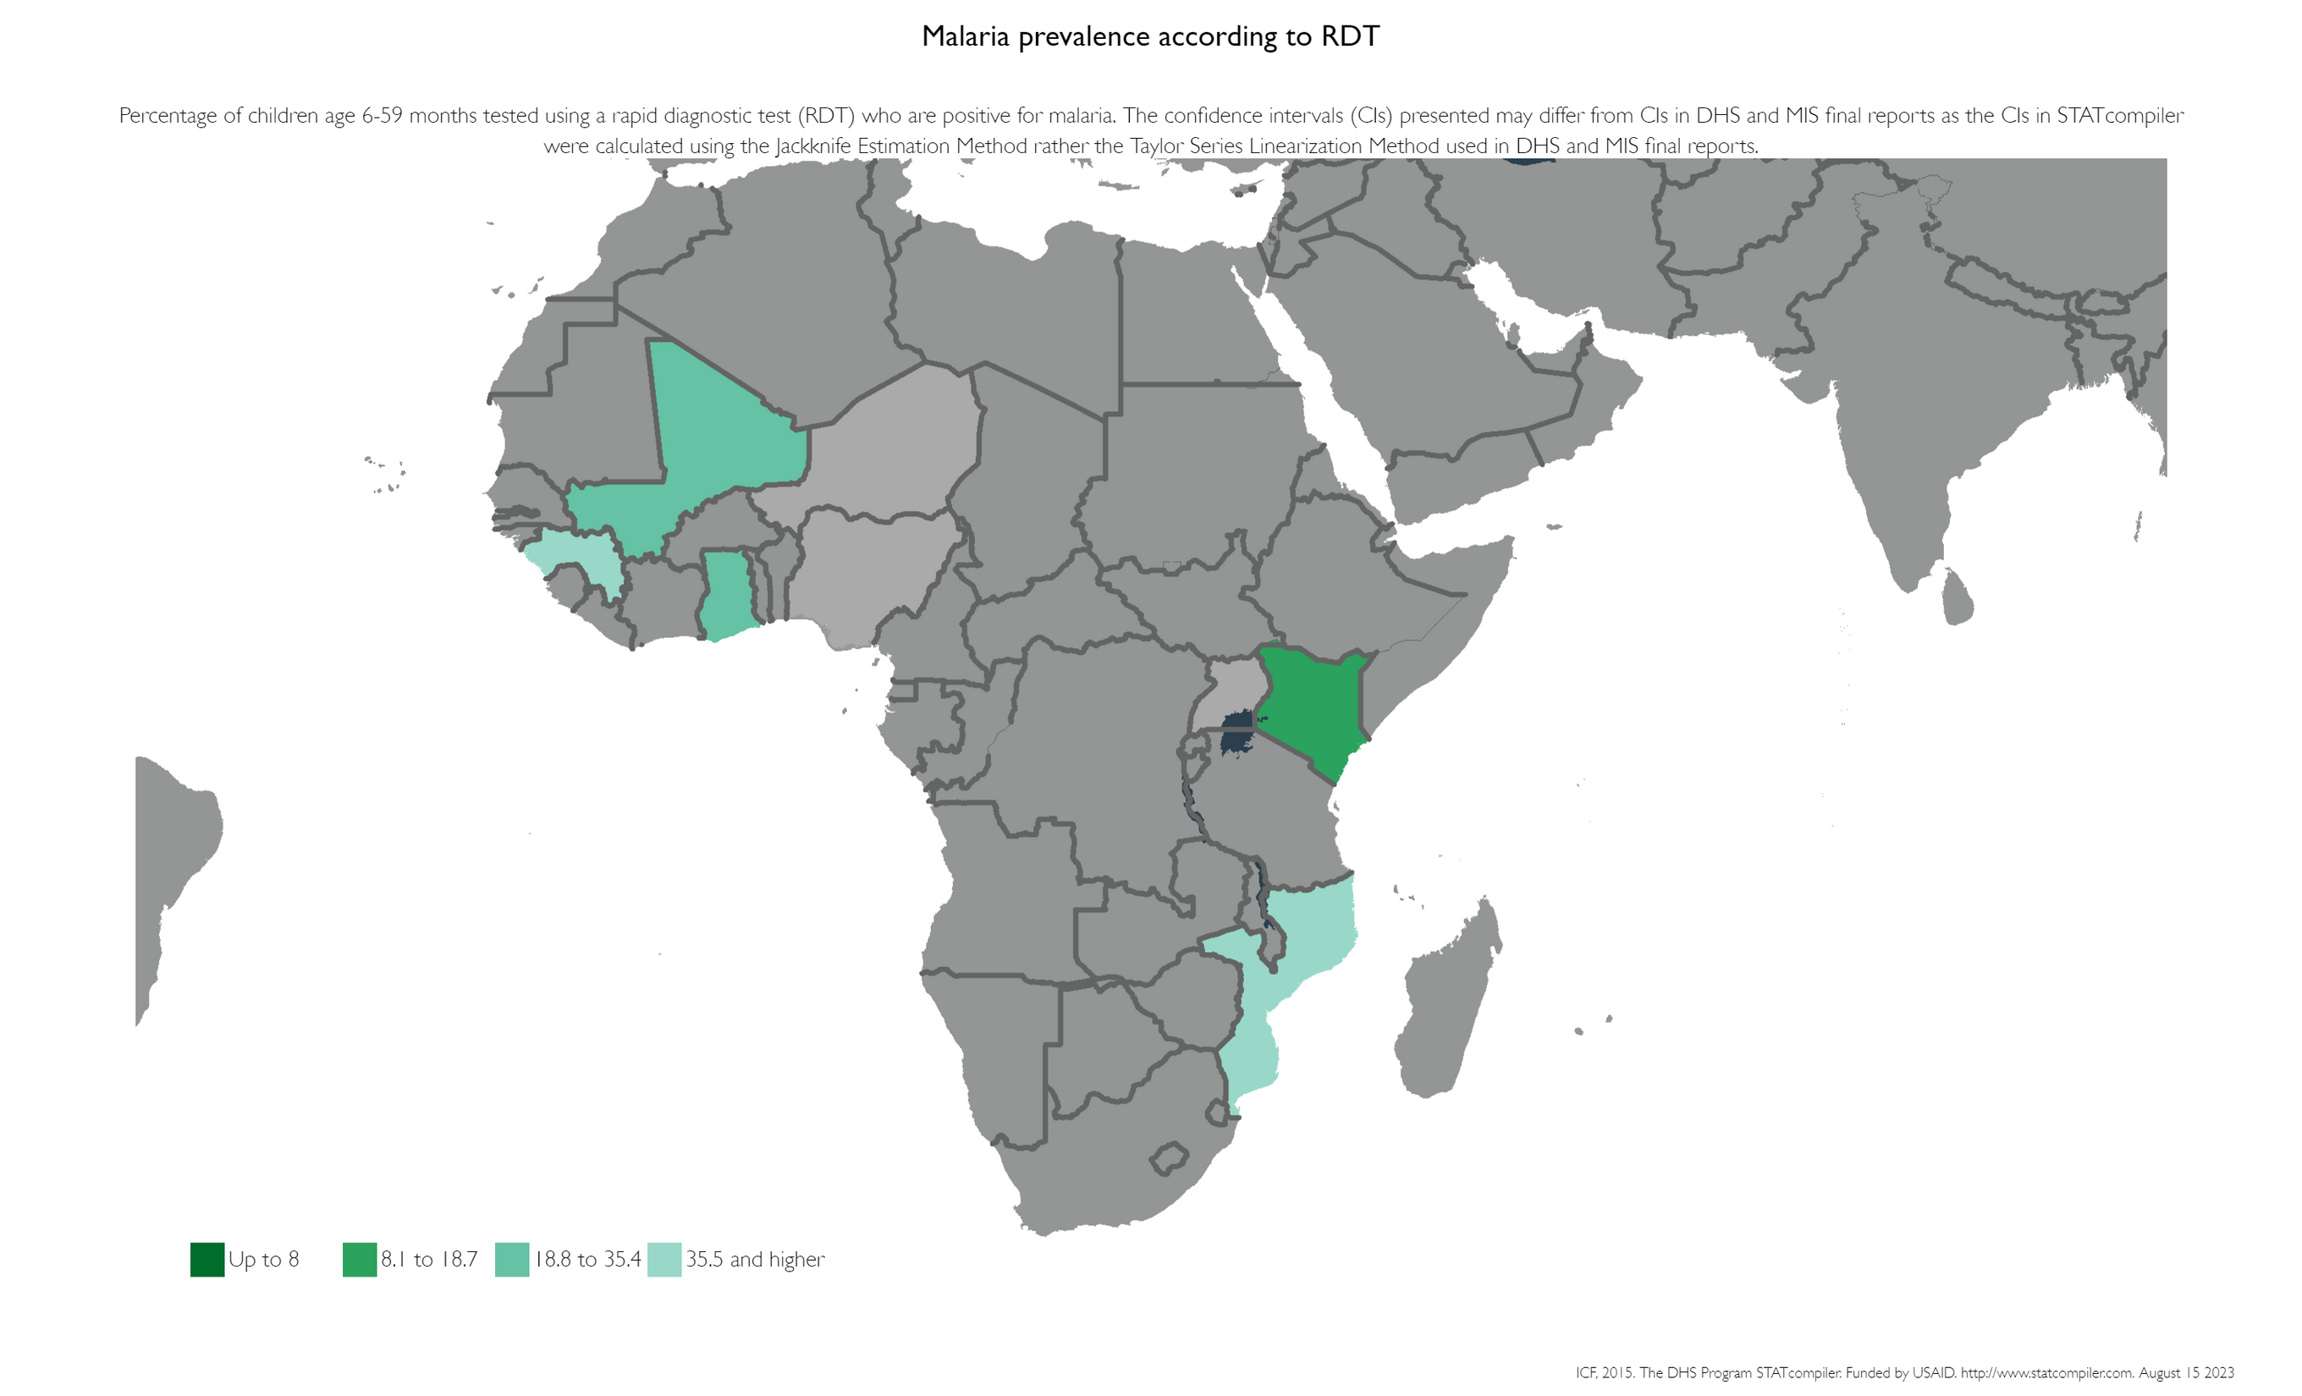
Malaria prevalence across study countries in
2014-2016
REFLEXIVITY
BACKGROUND
METHODOLOGY
RESULTS
CONCLUSIONS

Slide 37
Characteristics | Ghana | Guinea | Kenya | Mali | Mozambique | Niger | Nigeria | Uganda
≥ 35 years | 28.3 | 16.5 | 15.4 | 20.2 | 21.3 | 20.1 | 22.0 | 22.1
Rural resident | 56.1 | 72.7 | 63.8 | 80.2 | 71.1 | 83.6 | 72.2 | 69.6
Christian | 75.6 | 98.1 | 89.3 | 2.4 | N/A | N/A | 34.4 | 85.2
Reading literate | 49.5 | 20.2 | 84.1 | 20.1 | 44.7 | 12.5 | 46.7 | 60.6
≥ Secondary | 57.9 | 16.3 | 51.4 | 17.2 | 22.9 | 11.0 | 39.4 | 27.8
ITN use | 54.7 | N/A | 61.2 | 81.5 | 83.3 | 90.2 | 48.1 | 73.8
Female head of household | 32.3 | 13.0 | 27.6 | 4.3 | 28.7 | 6.8 | 6.6 | 25.8
Household water source | 29.7 | 18.0 | 34.7 | 35.6 | 37.4 | 33.1 | 15.7 | 19.8
Richest wealth quintile | 17.0 | 16.8 | 19.2 | 17.2 | 15.7 | 18.7 | 18.6 | 17.5
≥ 2 children under 5 | 45.6 | 72.5 | 75.8 | 85.6 | 50.9 | 71.5 | 69.4 | 57.4
Total | 2308 | 2147 | 2064 | 4934 | 3377 | 2734 | 5497 | 4826

Slide 38
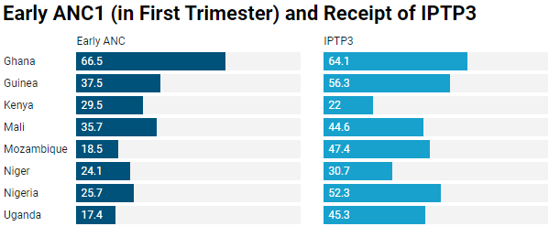
Suboptimal* levels of early ANC and IPTP3
*WHO Recommends 80% coverage of all malaria interventions
REFLEXIVITY
BACKGROUND
METHODOLOGY
RESULTS
CONCLUSIONS

