Slide 1
Prevention and Control of Malaria in Pregnancy
A Workshop for Health Care Providers
Notes:
1

Slide 2


This publication is adapted from the Prevention and Control of Malaria in Pregnancy Learning Resource Package made possible through support by United States Agency for International Development (USAID) under terms of Award No.
HRN-A-00-98-00043-00/Maternal and Neonatal Health Program, and by the Maternal and Child Health Division, Office of Health, Infectious Diseases and Nutrition, Bureau for Global Health, under the terms of the Leader with Associates Cooperative Agreement GHS-A-00-04-00002-00/ACCESS Program. The opinions expressed herein are those of the authors and do not necessarily reflect the views of USAID or the United States Government.
USAID did not contribute to the information in or funding of the 2015 edition or to the 2018 update.

Slide 3
Malaria in Pregnancy: Workshop Purpose
This workshop is designed to provide learners with the knowledge and skills they need to prevent, recognize, and treat malaria in pregnancy (MIP) in areas of moderate to high malaria transmission.
Antenatal care (ANC) is recommended as the platform for integration of evidence-based services for pregnant women, including services to prevent and treat MIP.

Slide 4
MIP: Workshop Purpose (continued)
The 2016 WHO recommendations on ANC state, “ANC provides a platform for important health-care functions, including health promotion, screening and diagnosis, and disease prevention. It has been established that by implementing timely and appropriate evidence-based practices, ANC can save lives. Crucially, ANC also provides the opportunity to communicate with and support women, families and communities at a critical time in the course of a woman’s life” (WHO 2016).
They support the WHO 2012 policy recommendation for intermittent preventive treatment of malaria in pregnancy with sulfadoxine-pyrimethamine (IPTp-SP) (WHO 2013c).

Slide 5
Workshop Specifics
Note to facilitators: Please complete this slide with information about your workshop schedule. Include relevant statistics about MIP in your country and/or region.

Slide 6
Introduction: Facts about Malaria
Worldwide, in 2019 there were about 229 million malaria cases in 87 malaria endemic countries, a decrease from 218 million in 2015; 90% of deaths from malaria occur in sub-Saharan Africa (SSA) (WHO 2015).
A reduction in the proportion of malaria cases caused by Plasmodium vivax occurred, from about 7% in 2000 to 3% in 2019.
Between 2015 and 2019 malaria case incidence (cases/1000 population at risk) declined by less than 2%, indicating a slowing in the rate of decline since 2015.
Between 2000 and 2019, in the six countries of the Greater Mekong subregion (GMS) – Cambodia, China (Yunnan Province), Lao People’s Democratic Republic, Myanmar, Thailand and Viet Nam – P. falciparum malaria cases fell by 97%, while all malaria cases fell by 90%. Of the 239,000 malaria cases reported in 2019, 65 000 were P. falciparum cases.
(World Malaria Report 2020)

Slide 7
Introduction: Facts about Malaria in Pregnancy
In 2019, in 33 moderate to high transmission countries in the World Health Organization (WHO) African Region, there were an estimated 33 million pregnancies, of which 35% (12 million) were exposed to malaria infection during pregnancy.
Pregnant women and young children are most at risk. Recent data indicate that up to 20% of stillbirths in sub-Saharan Africa may be attributable to MIP (Lawn et al. 2016).
10,000 maternal deaths occur annually from malaria-related anemia, and many more are likely to be directly or indirectly due to malaria infections
(Dellicour et al. 2010).
Despite a slight increase in coverage of three doses of intermittent preventive treatment (IPTp3) coverage from 31% in 2018 to 34% in 2019, coverage remains well below the global target of at least 80% and underscores the substantial number of missed opportunities, given that 62% of women receive IPTp1.

Slide 8
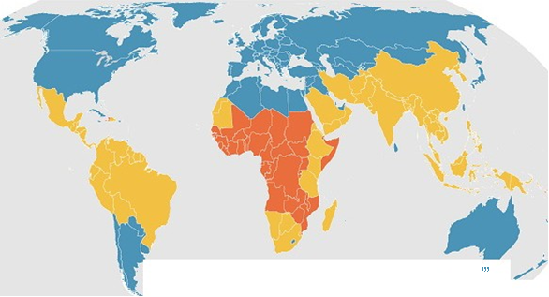
Endemicity: Plasmodium falciparum: global map (2020)
CDC 2020

Slide 9
Facts: Global Response to Malaria Control
Roll Back Malaria (RBM) was launched by WHO,
UNICEF, the United Nations Development Programme, and the World Bank in 1998 to provide a coordinated global approach to fight malaria.
RBM comprises more than 500 partners: governments, private groups, research organizations, civil society, and media.
Vision: by 2030 reduce malaria incidence and mortality rates globally by at least 90% compared with 2015 levels and eliminate malaria in a further 35 countries compared to 2015.
(Free advocacy resources and tools: http://rollbackmalaria.com/)

Slide 10
Global Response to Malaria Control (continued)
In April 2015, RBM released the Global Call to Action to Increase National Coverage of Intermittent Preventive Treatment of Malaria in Pregnancy for Immediate Impact:
  By 2030, achieve at least 90% coverage with three or more doses of IPTp in areas of stable malaria transmission for all malaria endemic countries.
The US President’s Malaria Initiative (PMI), also launched in 2005, aims to reduce malaria-related deaths by 50% in 19 high-burden countries. PMI set a target for use of insecticide-treated nets (ITNs) and IPTp by pregnant women at 85%.

Slide 11
Global Response to Malaria Control (continued)
The Global Technical Strategy for Malaria 2016–2030
was adopted by the World Health Assembly in May 2015:
  Sets the target of reducing global malaria incidence and mortality rates by at least 90% by 2030.
  Emphasizes the need for universal coverage of core malaria interventions for all populations at risk and highlights the importance of using high-quality surveillance data for decision-making (WHO 2015c).

Slide 12
Global Response to Malaria Control (continued)
Transforming Intermittent Preventive Treatment of Malaria
in Pregnancy for Optimal Pregnancy, funded by Unitaid,
2017–2022:
  The introduction of IPTp in the early 2000s increased opportunities for pregnant women to protect themselves and their unborn babies from the detrimental consequences of MIP.
  IPTp uptake has fallen short of set targets in most sub-Saharan African countries. In 2014, a global call to action to increase IPTp uptake was launched and engendered great momentum at global and country levels to reprioritize MIP programming and address shortfalls in IPTp uptake.
  This project will introduce community IPTp with quality-assured SP to help generate the evidence for WHO review.

Slide 13
Prevention and Control of MIP
Module 1: ANC
Notes:
13

Slide 14
ANC: Module 1 Learning Objectives
Define ANC and list the main goals of ANC.
Describe WHO’s three-pronged approach to MIP.
Discuss the timing of ANC contacts.
Discuss modifications to ANC necessitated by the COVID-19 pandemic.
Describe the essential elements of a birth preparedness/complication readiness plan.
Describe health system factors to support recordkeeping for ANC.

Slide 15
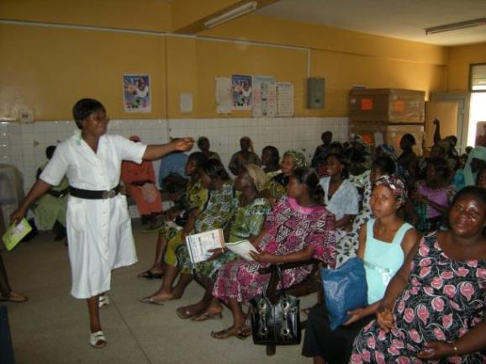
Group Education in ANC Clinic in Ghana
Antenatal care: Ghana
Photo by: William Brieger/Jhpiego

Slide 16
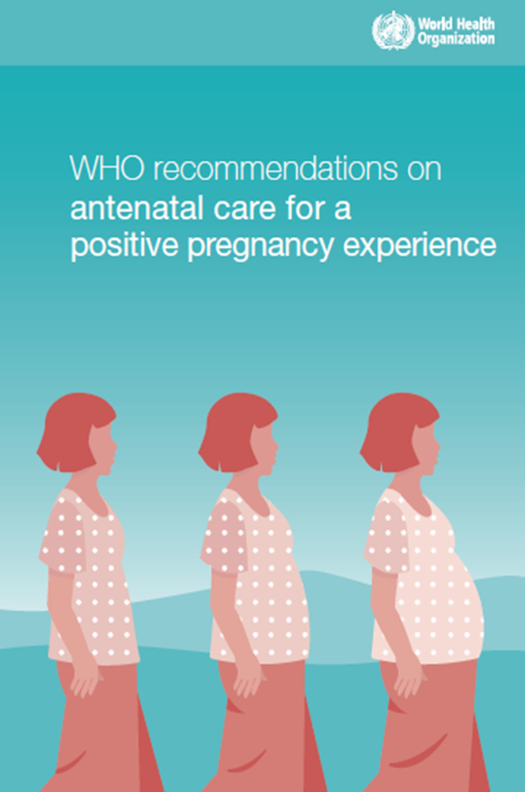
Improving the Experience of ANC: The 2016 WHO Recommendations

Slide 17
Background: Revised WHO Recommendations for ANC
The purpose of the 2016 WHO recommendations
is to:
  Place the woman at the center of care.
  Promote innovative, evidence-based approaches to ANC.
  Enhance the woman’s experience of pregnancy and ensure that babies have the best possible start in life.
  Align with the Sustainable Development Goals to expand care beyond survival, prioritizing person-centered health and well-being, not only the prevention of death and morbidity.

Slide 18
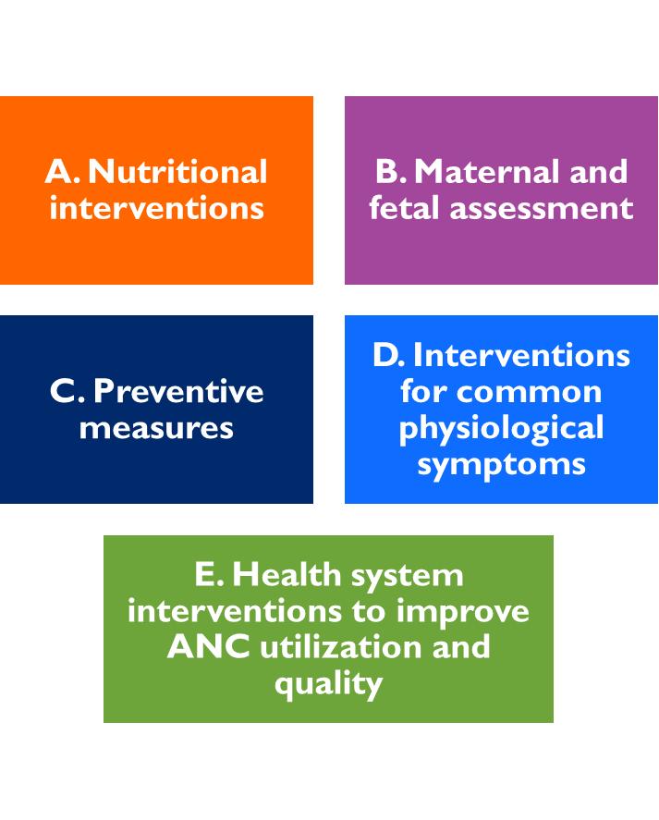
Content of the 2016 WHO Recommendations for ANC
Divided into five categories and contains 39 recommendations.
Specific recommendations will be cited in this workshop as they pertain to routine ANC and prevention and treatment of MIP.

Slide 19
Focused ANC versus Current WHO Recommendations
Until the release of the 2016 WHO recommendations for ANC, the most commonly used approach was focused ANC, which centered on a woman’s needs but relied on fewer visits. The new recommendations call for a minimum of eight contacts during pregnancy to improve perinatal outcomes and maternal satisfaction.

Slide 20
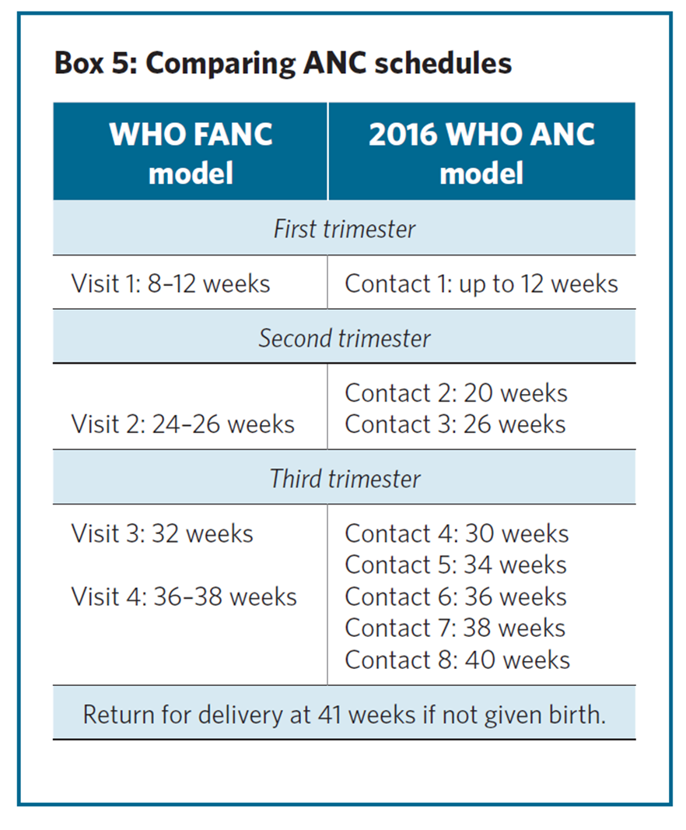
Timing of ANC Contacts
A minimum of eight ANC contacts is recommended to reduce perinatal mortality and improve women’s experience of care.
The word “visit” is replaced with “contact” to imply active engagement between the pregnant woman and her health care provider.

Slide 21
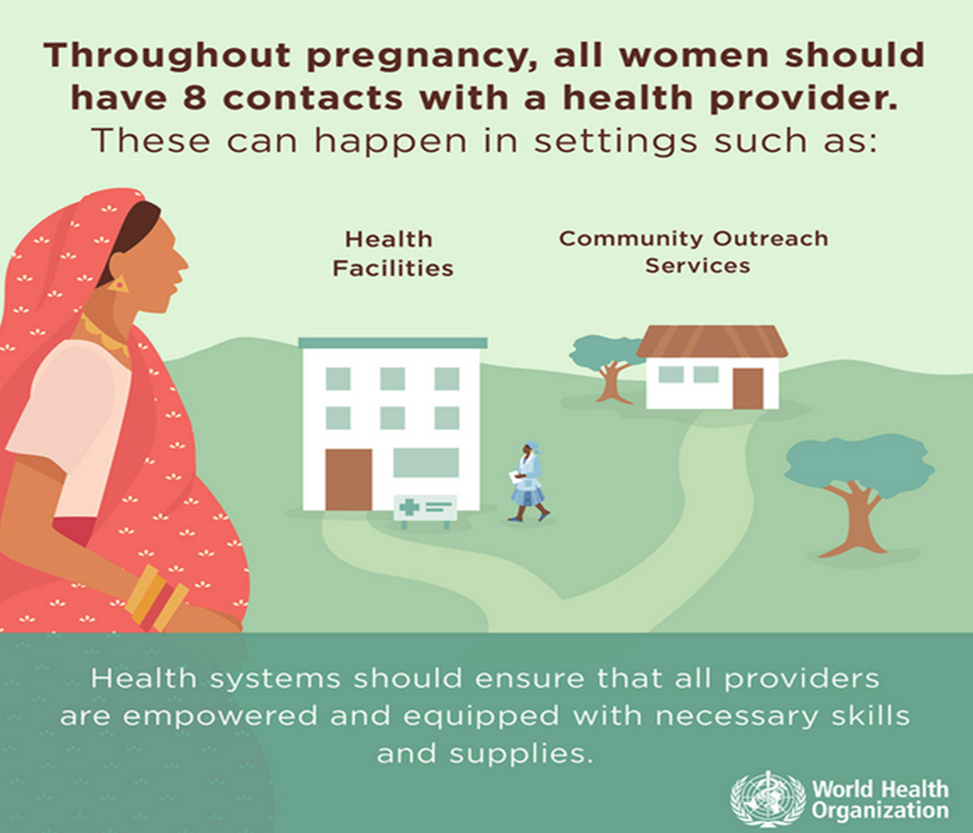
Settings for ANC
“Contact” can be adapted to local contexts through community outreach programs and lay health worker involvement.

Slide 22
Components of ANC
The components of ANC include:
  Risk identification
  Prevention and management of pregnancy-related or concurrent diseases
  Health education and health promotion

Slide 23
Risk Identification
ANC promotes targeted assessment, during which
the health care provider interviews, examines, and tests the woman to determine her risk of developing pregnancy-related complications and conditions that are common in the population being served.

Slide 24
Prevention and Management of Pregnancy-Related or Concurrent Diseases
The following antenatal complications are major causes of maternal and newborn mortality:
  Hemorrhage
  Fetal malposition/malpresentation
  Pre-eclampsia/eclampsia
  Sepsis/infection
  Malaria
  HIV/AIDS

Slide 25
Prevention and Management of Pregnancy-Related or Concurrent Diseases (continued)
Targeted assessment includes detection of signs and symptoms of pregnancy-related complications (such as placental abruption) and/or pre-existing diseases (such as diabetes). The health care provider also manages these complications or provides initial management and stabilization, including lifesaving measures as needed.
Facilitating management or referral to a higher level of care is an important role of the ANC provider.

Slide 26
Health Education and Health Promotion
ANC promotes setting aside time during each contact
to discuss important health issues.
The health care provider should ensure that the woman and her family have the information they need to make healthy decisions during pregnancy, childbirth, and the postpartum/newborn period, and sufficient guidance in applying that information in their particular situation.

Slide 27
Health Education and Health Promotion (continued)
Important aspects to include in each ANC contact are:
  Healthy eating
  Care for common discomforts
  Avoiding use of potentially harmful substances (alcohol and tobacco, and drugs not prescribed by the provider)
  Handwashing and personal hygiene
  Physical activity and rest
  Sexual relations and safer sex
  Early and exclusive breastfeeding
  Family planning/healthy timing and spacing of pregnancies

Slide 28
Health Education and Health Promotion (continued)
Birth preparedness and complication readiness is an
intervention included by WHO as an essential element of
the ANC package (WHO 2015d). If a woman is well prepared for normal childbirth and possible complications, she is more likely to receive the timely care from a provider that is needed to protect her overall health, and possibly save her life and the life of her newborn.
The birth plan helps to ensure that necessary preparations for normal childbirth are made well in advance of the estimated delivery date. Since every woman and her family must be prepared to respond appropriately in an emergency, the birth plan should also address complication readiness (see reference manual for details).

Slide 29
Health Education and Health Promotion (continued)
Major components of the birth plan include:
  Choosing a health care provider to attend the birth
  Place of birth
  Transportation for normal birth and in case of emergencies/referrals
  Funds for normal birth and complications/emergencies
  Decision-making
  Support during birth and at home after the birth
  Identifying a blood donor
  Items for a clean and safe birth
  Signs of labor and danger signs

Slide 30
Health Education and Health Promotion (continued)
Danger signs in pregnancy
  Vaginal bleeding
  Difficulty breathing
  Fever
  Severe abdominal pain
  Severe headache/blurred vision
  Convulsions/loss of consciousness
  Persistent cough, night sweats, blood-tinged sputum
  Labor pains/loss of amniotic fluid before 37 weeks

Slide 31
Health Promotion Messages Specific to MIP
In areas with a malaria risk, pregnant women and their families should
receive the following health care, messages, and counseling:
IPTp-SP (in areas of moderate to high transmission) works to protect against malaria and its complications. Women should be counseled about the importance of returning for continued ANC contacts.
The 2012–2013 WHO recommendations for pregnant women, including the following:
  As early as possible during the second trimester (13 weeks and after), give IPTp-SP, three tablets at one time (each tablet contains sulfadoxine 500 mg/pyrimethamine 25 mg), using directly observed therapy.
  IPTp-SP should be given at each scheduled ANC contact, at least 1 month apart.
  The last dose of IPTp-SP can be administered until the time of delivery without safety concerns.

Slide 32
Health Promotion Messages Specific to MIP (continued)
  SP can be given on an empty stomach or with food.
  Folic acid at a daily dose equal to or above 5 mg should not be given with SP because it counteracts SP’s efficacy as an antimalarial.
  A daily dose of iron and folic acid supplementation in pregnant women at the dose of 30–60 mg of elemental iron and 0.4 mg of folic acid is recommended. Combined, the two will help reduce the risk of low-birthweight infants, maternal anemia, and iron deficiency at term.
  SP should not be administered to women living with HIV who are receiving co-trimoxazole prophylaxis.

Slide 33
Health Promotion Messages Specific to MIP (continued)
Provide info on ITNs, such as:
  Where to find them
  How to use them effectively
  How they work
  Their benefits and safety for the pregnant woman and fetus in malaria risk areas
ITNs should be provided to women as early in the pregnancy as possible. Ideally, all women should sleep under ITNs so they are protected even before they become pregnant.

Slide 34
Health Promotion Messages Specific to MIP (continued)
Women with suspected malaria must go immediately
to a health facility, and compliance with the treatment regime must be ensured (see Appendix B for WHO/USAID/MCSP Implementing Malaria in Pregnancy Programs in the Context of World Health Organization Recommendations on Antenatal Care for a Positive Pregnancy Experience).
Malaria prevention: What the woman and her family can do to minimize mosquito bites.

Slide 35
Other Vital Components of ANC
Prevention of tetanus and anemia:
  Tetanus toxoid immunization
  Daily oral iron and folic acid supplementation with 30–60 mg of elemental iron and 0.4 mg of folic acid
  Preventive treatment for hookworm infection in endemic areas, after the first trimester

Slide 36
Other Vital Components of ANC (continued)
Prevention of mother-to-child transmission of HIV (PMTCT):
  In high-prevalence settings (less than 5% HIV prevalence in the population that is being tested), provider-initiated testing and counseling for HIV should be done routinely in all ANC settings.
  In low-prevalence settings, provider-initiated testing and counseling can be considered for pregnant women in ANC settings as a key component in the effort to eliminate mother-to-child transmission of HIV.
  Integrate HIV testing with syphilis, as relevant to the setting.
  Strengthen the underlying maternal and child health systems.

Slide 37
Other Vital Components of ANC (continued)
Many men are uncertain about how they can contribute to a healthy outcome for their partners and their babies. Depending on the woman’s preference and cultural norms, a man can be encouraged to:
  Support and encourage the woman throughout pregnancy.
  Ensure adequate rest and healthy eating.
  Provide financial support for normal birth, complications, and care of the newborn.
  Help the woman make a birth and complication readiness plan.

Slide 38
Other Vital Components of ANC (continued)
  Encourage the woman to attend the antenatal clinic as early as possible in pregnancy and then as recommended thereafter.
  Encourage the woman to take her SP under provider supervision.
  Make sure the woman has an ITN and sleeps under it every night before, during, and after pregnancy.
  Use condoms consistently and correctly to prevent sexually transmitted infections/HIV.
  Accompany his partner to the health facility and during childbirth.

Slide 39
Scheduling and Timing of Antenatal Contacts
Appropriate scheduling depends on the woman’s gestational age and individual needs. For women whose pregnancies are progressing normally, WHO now recommends a minimum of eight ANC contacts (WHO 2016c).

Slide 40
Scheduling and Timing of Antenatal Contacts (continued)
These contacts may take place at or around the times listed:
  First contact: Ideally, this contact should take place in the first trimester (by 12 weeks).
  Second and third contacts: Two contacts should take place in the second trimester, ideally at 20 and 26 weeks.
  Fourth through eighth contacts: These should take place at about 30, 34, 36, 38, and 40 weeks.
If the woman has not given birth by 41 weeks, she should be referred for delivery.

Slide 41
Scheduling and Timing of Antenatal Contacts (continued)
WHO recommends that, in areas of moderate to high malaria transmission in Africa, IPTp-SP should be given to all pregnant women at each scheduled ANC contact, starting as early as possible in the second trimester, provided that the doses of SP are given at least 1 month apart.
WHO recommends a package of interventions for preventing MIP, which includes promotion of ITNs and IPTp-SP. To ensure that pregnant women in endemic areas start SP as early as possible in the second trimester, policymakers should ensure health system contact with women at 13 weeks gestation.

Slide 42
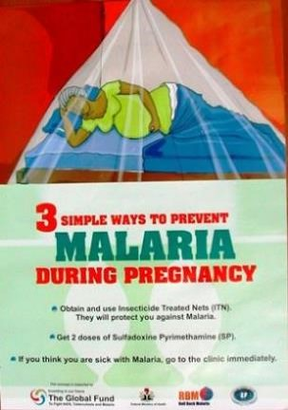
Nigerian Federal Ministry of Health Poster
Example of one country’s plan:
Three ways to prevent
malaria during pregnancy:
  ITNs
  IPTp-SP
  Case management, for women with malaria symptoms
Photo courtesy of Nigeria Federal Ministry of Health

Slide 43
Scheduling and Timing of Antenatal Contacts (continued)
Please see the reference manual, Table 1. 2016
ANC contact schedule with timelines for implementation of malaria in pregnancy interventions for thorough review of the eight recommended ANC contacts and MIP-related interventions.

Slide 44
Scheduling and Timing of Antenatal Contacts (continued)
The period between 13 and 20 weeks is a critical period for
irreversible negative consequences of MIP, when parasite densities are highest and major benefit can be achieved from malaria prevention.
For effective MIP programming, a contact with the provider early during the second trimester (between 13 and 16 weeks) is critical to ensuring timely access to the first dose of IPTp-SP for maximal impact.
While the practice in many countries is to give the first dose of
IPTp-SP at quickening (woman’s first awareness of fetal movement), this can leave the pregnant woman and fetus unprotected for several weeks, depending on variations in women’s perception of quickening (WHO 2017).

Slide 45
Scheduling and Timing of Antenatal Contacts (continued)
A Toolkit to Improve Early and Sustained Intermittent Preventive Treatment in Pregnancy (IPTp) Uptake has been developed to assist providers in assessing gestational age in the second trimester (USAID and MCSP 2017).
An important component of the toolkit is the job aid, Prevention of Malaria during Pregnancy: Administer
IPTp-SP Starting at 13 Weeks, which can be found in Appendix B of the reference manual.

Slide 46
Scheduling and Timing of Antenatal Contacts (continued)
Also see the reference manual, Table 2. Components
of antenatal care contacts (for pregnant women in moderate- to high-transmission areas), for a full description of ANC interventions by trimester and ANC contact.

Slide 47
ANC in the context of the COVID-19 pandemic
The impact of SARS-CoV-2, the new strain of coronavirus responsible for COVID-19, has led to the disruption of provision of health care services globally, resulting in an increase in the number of deaths from non-COVID-19 causes
Equitable access to health services is threatened as clients fear use of or are barred from routine health services, and human resources and commodities are redirected to care for those affected with COVID-19 (WHO 2020d).
In a multinational study of pregnant women in 18 countries, women with COVID-19 were at increased risk of morbidity and mortality, including preterm birth; newborns of women with COVID-19 had significantly higher severe morbidity and mortality compared with newborns of women without COVID-19 diagnosis (Villar 2021). Thus, care during pregnancy, labor, birth and the postpartum period must remain a priority of the health system.

Slide 48
ANC in the context of the COVID-19 pandemic: important considerations
Women have concerns about the safety of care in health facilities, including exposure to COVID-19. It is therefore vital to adapt ANC services to continue to serve and protect providers and clients. (WHO 2020b, TIPTOP 2020, RBM 2020a).
Important considerations include:
  Distancing of two meters
  Infection prevention and control: hand hygiene; appropriate use of personal protective equipment (PPE), including cloth face coverings for clients, and gloves, masks, face shields, and gowns for providers, depending on the service provided

Slide 49
ANC in the context of the COVID-19 pandemic: important considerations (continued)
  Surface and environmental cleaning and disinfection
Establish effective patient flow (screening, triage, and targeted referral) at all levels
  Reorganize to include a screening area at the facility entrance and use standard operating procedures to isolate staff and clients with suspected or confirmed COVID-19.
  Develop a system to direct clients with danger signs (obstetric and/or COVID-related) to appropriate services for management.
  Develop a patient flow system that minimizes contact between clients.
  Consider use of a booking system for appointments (clinical consultation, medication pickup, and laboratory work) to help minimize crowding and wait times.
ddd

Slide 50
ANC in the context of the COVID-19 pandemic: offsite triage
  Consider use of a booking system for appointments (clinical consultation, medication pickup, and laboratory work) to help minimize crowding and wait times.
Offsite triage
  Consider triage via phone if clients have access to one and are willing to communicate with health care providers in this manner. To support triage by phone, a specific format should be developed and followed for each call. During each call, the provider should ask about and provide counseling on: danger signs, nutrition, rest, hygiene, birth preparedness/complication readiness, ITN use, presence of depression or anxiety.
ff

Slide 51
ANC in the context of the COVID-19 pandemic: onsite screening and triage
Onsite screening and triage:
  Ensure hand hygiene at facility entrances (i.e., handwashing stations and/or alcohol-based hand rub) for all clients. Ask clients to wear cloth face coverings. Healthcare workers should wear face masks and perform hand hygiene after each client encounter.
  Identify clients with respiratory symptoms and/or respiratory distress and isolate them while immediately directing them to the appropriate service for clinical evaluation, and follow up with/refer and manage as needed.
ddd

Slide 52
ANC in the context of the COVID-19 pandemic: onsite screening and triage (continued)
  Perform temperature checks for clients and their companions at the facility entrance, isolating anyone with a temperature ≥38°C; assess clinical symptoms (especially respiratory distress), and/or contact with persons with suspected or confirmed COVID-19 using a simple checklist. Clients with suspected or confirmed COVID-19 should be isolated immediately. Note that because at least 30% of clients with COVID-19 do not have symptoms, use of masks and social distancing is imperative.
  In areas of malaria transmission, all clients with fevers should be screened for malaria using rapid diagnostic tests (RDTs), and clients with malaria should receive prompt case management. Clients may be infected with both COVID-19 and malaria, but until the diagnoses are established, providers should minimize exposure of clients diagnosed with malaria to COVID-19.

Slide 53
ANC in the context of the COVID-19 pandemic: onsite screening and triage; considerations specific to ANC services
  Provide a comfortable, well-ventilated waiting area, ideally a separate waiting area for potentially ill clients, or at least an area where distancing can be ensured.
  Minimize involvement of nonclinical staff in triage, and provide training for them on COVID-19 triage, screening, standard precautious, and PPE, with direct communication and support to clinical backstop.
Considerations specific to ANC services:
  Deliver ANC according to national guidelines to the extent possible, making modifications as needed to protect clients and encourage ANC attendance.

Slide 54
ANC in the context of the COVID-19 pandemic: considerations specific to ANC services (continued)
  Where comprehensive facility-based services are disrupted, prioritize ANC contacts for low-risk pregnant women during the third trimester and for all pregnant women who are assessed as high risk, including women with comorbidities, women who are underweight or overweight, adolescent girls, women at risk of common maternal mental health conditions, and other vulnerable groups.
  Ensure that women adapt birth preparedness and complication readiness plans to consider changes to services, and that they are aware of danger signs signaling immediate need to contact a health provider: bleeding, respiratory difficulties, high fever, severe headache, etc.

Slide 55
ANC in the context of the COVID-19 pandemic: considerations specific to ANC services (continued)
  Discontinue group counseling and group ANC sessions until related restrictions are lifted or until appropriate PPE and distancing measures can be ensured. Prioritize ANC counseling messages to shorten sessions.
  During individual counseling, maintain a 1- to 2-meter distance between the health care worker and client (in the client’s home, community, or facility), and maintain this distance between clients in waiting areas and queues.
  Where possible, use a simple booking system for appointments, or increase frequency of ANC sessions, to decrease client volume per ANC session.

Slide 56
ANC in the context of the COVID-19 pandemic: considerations specific to ANC services (continued)
  Discuss the most common symptoms of COVID-19 infection (fever, fatigue, cough, and shortness of breath) with clients. Other symptoms may include loss of appetite, malaise, muscle pain, sore throat, nasal congestion, headache, diarrhea, nausea, and vomiting. Some people may not have signs or symptoms of COVID-19 infection, but can still pass the infection to others.
  Counsel pregnant women to maintain a distance of 2 meters from everyone (except intimate household members without symptoms) or per national guidance. Encourage use of face coverings at all times outside the home (WHO 2021).

Slide 57
ANC in the context of the COVID-19 pandemic: considerations specific to ANC services (continued)
  Perform physical exams respectfully and quickly to minimize close contact to the extent possible, using appropriate PPE.
  Offer ITNs at the first contact, along with 2–3 months of recommended micronutrient supplements.
  Communicate specific dates for return to ANC to receive IPTp-SP by directly observed therapy monthly, if possible.
  Ensure supplies of clean drinking water and cups, or ask clients to bring their own water and cups.
  Ensure targeted outreach strategies are implemented where coverage and care seeking have declined.
aa

Slide 58
ANC in the context of the COVID-19 pandemic: considerations specific to ANC services (continued)
  Plan for catch-up of missed ANC contacts, including delivery of tetanus toxoid vaccines and HIV and syphilis testing. Establish mechanisms for ensuring continued early delivery of missed contacts or content.
  Consider relocating ANC from hospital environments to the community and where possible, recommend a route to the ANC clinic that bypasses other areas of the facility that may expose the client to COVID-19.
  Provide a “one-stop” contact, that is, combine services such as tests and medication administration at the same contact to reduce the number of visits women must make to the facility.
  Follow country guidelines on vaccination of pregnant and breastfeeding women against COVID-19.

Slide 59
Recordkeeping for Antenatal Contacts and Malaria Prevention Activities
The following are necessary:
Adequate monitoring of the woman’s condition
Continuity of care
Effective communication among health care providers and among health care sites (if referred)

Slide 60
Recordkeeping Responsibilities
Health facility:
  Establishes and maintains a record for every woman and newborn
  who receives care.
Provider:
  Gathers information, records it, refers to it, and updates it at the time of each contact.
  Ensures that information is accurate and clearly written.
Woman:
  Should be encouraged to keep her ANC card or booklet in a safe place. She should bring it to every contact and to the facility for labor and birth.

Slide 61
Recordkeeping Procedure
Record all information on the ANC card and clinic card:
First ANC contact:
  History
  Physical examination
  Testing/screening as appropriate (e.g., malaria, HIV, TB)
  Provision of care, including IPTp, tetanus toxoid, and iron/folate
  Discussion of health messages, including birth plan, malaria prevention (use of ITNs), and danger signs
  Date of next ANC contact

Slide 62
Recordkeeping Procedure (continued)
Subsequent ANC contacts:
  Interim history
  Targeted physical examination, testing
  Provision of care, including IPTp-SP, if appropriate
  Discussion of health messages (including review/revision of birth plan)
  Counseling/testing for HIV, if not done previously or if woman requests it
  Date set for next ANC contact

Slide 63
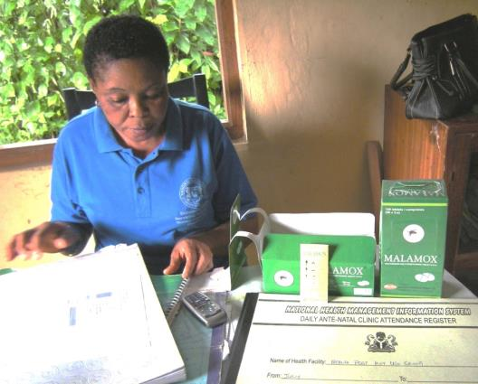
Maintaining antenatal care records in Nigeria
Photo by: William Brieger/Jhpiego

Slide 64
Respectful Maternity Care
One of the major reasons that women do not attend ANC or give birth in facilities is the perceived lack of respectful treatment by providers. The White Ribbon Alliance worked with global organizations to formulate the Respectful Maternity Care: Universal Rights of Childbearing Women (2011) charter, which includes:
  Freedom from harm
  Right to information, informed consent and refusal, and respect for choices and preferences, including companionship during maternity care
  Confidentiality and privacy

Slide 65
Respectful Maternity Care (continued)
  Dignity, respect
  Equality, freedom from discrimination, and equitable care
  Right to timely health care and to the highest attainable level of health
  Liberty, autonomy, self-determination, and freedom from coercion

Slide 66
Respectful Maternity Care (continued)
Respectful maternity care considers the woman to be an
active participant in her health, with rights and values that must be respected. It applies to assistance by a provider throughout the continuum of care, from ANC to labor, birth, and postnatal care.
It includes the recognition of women’s preferences and needs. Active steps must be taken to ensure and monitor for respectful maternity care, prevent disrespect and abuse, and take action to address them if they occur, ideally through facility-based quality improvement approaches.
For further information on quality improvement, please refer to the WHO’s Standards for Improving Quality of Maternal and Newborn Care in Health Facilities.

Slide 67
Respectful Maternity Care (continued)
Part of respectful maternity care is the use of positive interpersonal communication skills during every encounter with clients, including:
  Ensuring auditory and visual privacy during the ANC contact
  Speaking in a quiet, gentle tone of voice, using easily understood terms and language
  Listening to the woman/family and responding appropriately (active listening)
  Encouraging them to ask questions and express concerns

Slide 68
Respectful Maternity Care (continued)
  Allowing them to demonstrate understanding of information provided
  Observing for unusual signs
  Explaining all procedures/actions and obtaining permission before proceeding
  Showing respect for cultural beliefs and social norms
  Being empathetic and nonjudgmental
  Avoiding distractions while conducting the contact
  Thanking the client and reminding her when to come again

Slide 69

Respectful Maternity Care (continued)
Remember:
Respectful care is a lifesaving skill.
The treatment of and care for each client should result in her choosing to return to your facility for care whenever needed.
Pregnant woman riding on bicycle to antenatal care contact.
Photo by: Peter Chisambiro

Slide 70
Prevention and Control of Malaria in Pregnancy
Module 2: Malaria Transmission

Slide 71
Malaria Transmission: Module 2 Objectives
Define malaria and how it is transmitted.
Describe the extent of malaria in Africa in general and in your own country.
Compare the effects of malaria in areas of stable and unstable transmission.
List the effects of malaria on pregnant women, their unborn babies, and the community.
Describe the effects of malaria on pregnant women living with HIV/AIDS.
Discuss integration of MIP and PMTCT services into ANC.

Slide 72
Malaria Transmission: Background
Caused by Plasmodium parasites:
Plasmodium falciparum:
  These are the most common type in much of Africa.
  Causes the most severe disease.
Plasmodium vivax
Plasmodium ovale
Plasmodium malariae
Plasmodium knowlesi (occurs naturally in monkeys in Southeast Asia but is now known to cause disease in humans)

Slide 73
Malaria Transmission: Background (continued)
Malaria is spread by female Anopheles mosquitoes
infected with parasites.
Anopheles mosquitoes are usually active at night.
Malaria parasites reproduce in human blood.
A mosquito bites an infected person, is infected with parasites, and then goes on to bite and infect another person.

Slide 74

Anopheles Mosquito
Anopheles mosquitoes differ from other mosquitoes in the way their body is positioned. The body of the Anopheles mosquito points up in the air in one line, but the body of other mosquitoes is bent, and the rear end points down.
Source: WHO 2004C.

Slide 75
Factors Affecting Transmission
Breeding sites
Type of vector
Parasites
Climate
Population

Slide 76
Breeding Sites
Stagnant or slow-flowing bodies of water:
  Small ponds, ditches, pits, and canals
  Swamps, reservoirs, and rice fields
  Pools of water after rain
  Uncovered water tanks
  Streams with slow-flowing water along banks
  Water-filled animal hoof prints
  Objects that collect water: empty tins, containers
  Holes in tree trunks

Slide 77
Types of Vector
The principal vector is the Anopheles mosquito.
Different Anopheles species exist in different parts of the world.
Some Anopheles species are more efficient in transmitting malaria than others.

Slide 78
Parasites and Climate
Enough parasites must exist in the human population
to infect the mosquito.
The environmental temperature must average at least
18–20°C and humidity must stay above 60% for the mosquito to survive and the parasite to develop.
The warmer the weather, the faster the development of the parasite.

Slide 79
Population
In Africa, Anopheles mosquitoes do not fly farther than about 1–2 km from their breeding sites unless they are aided by wind.
People must be near or within a short distance of these breeding sites to be bitten by the infected mosquito.

Slide 80
Populations Most Affected by Malaria
Pregnant women:
  Are more likely than nonpregnant women to become infected and develop signs and symptoms.
  Women in first or second pregnancies are more at risk.
Children under 5 years of age:
  About 90% of malaria deaths occur in Africa, and the majority are among children under 5 years old (WHO 2014b).
Unborn babies
Immigrants from low-transmission areas
HIV-infected people

Slide 81
Transmission Levels: Stable Transmission Areas
Stable transmission areas are places where populations are continuously exposed to a fairly constant rate of malaria infection.
Immunity develops during childhood.
Adolescents and adults are partially immune, although they may have a few parasites in their blood.
Immunity is reduced in pregnancy and can be lost if someone moves out of the high-transmission area for a long time.
Pregnant women and children in areas of stable transmission have the highest risk of becoming ill from malaria.

Slide 82
Stable Transmission
Possible outcomes of a malaria infection
A small proportion develop signs and symptoms
A large proportion are immune and have no signs and symptoms
Disease with signs and symptoms
Asymptomatic infection
Severe disease
Placental sequestration
Altered placental integrity
Less nutrient transport
Spontaneous abortion
Maternal and fetal death
Anemia
Low birthweight
Adapted from WHO 2004c.
Maternal morbidity
Higher infant mortality

Slide 83
Transmission Levels: Unstable Transmission Areas
Population is not exposed to malaria very often.
Malaria is sometimes seasonal (e.g., rainy season).
Population develops little or no immunity.
Children and adults, including pregnant and nonpregnant women, are all equally susceptible to malaria.

Slide 84
Transmission Levels: Unstable Transmission Areas (continued)
MIP can be very serious, and complications may occur
in a short time.
Pregnant women usually present with fever, clinical signs or symptoms, and sometimes severe malaria, which is
life threatening.
Common outcomes of malaria infection in unstable
areas include:
  Abortion
  Stillbirth
  Low birthweight

Slide 85
Unstable Transmission
Acquired immunity: low or none
Clinical illness
Severe disease
All pregnancies are at risk.
Key intervention strategies: disease recognition and case management
Risk to mother
Risk to fetus
Source: WHO 2004.
Notes:
85

Slide 86
Transmission Levels: Mixed Transmission Areas
Different levels of transmission can occur within a country or region.
Within a malarious region (such as southern Africa),
there can also be malaria-free areas.
Factors affecting transmission include temperature, humidity, and altitude.
  The life span of the mosquito is increased with high humidity, while cold weather (below 16°C) slows the development of the malaria parasite.

Slide 87
Effects of Malaria on Pregnant Women
All pregnant women in malaria-endemic areas are at risk.
The placenta becomes susceptible to malaria infection at
the end of the first trimester (Walker et al. 2014).
Parasites attack and destroy red blood cells.
Malaria causes up to 25% of anemia in pregnancy
(Schantz-Dunn and Nour 2009).
Malaria can cause severe anemia.
In Africa, malaria-related anemia causes up to 10,000 maternal deaths per year (ALMA 2009).

Slide 88
Effects of Malaria on Pregnant Women (continued)
Approximately 11% of newborn deaths in malaria-endemic African countries are due to low birthweight resulting from
P. falciparum infections during pregnancy.
Effects range from mild to severe, depending on the
level of malaria transmission in a particular setting
and the pregnant woman’s level of immunity.
The level of immunity depends on several factors:
  Intensity of malaria transmission
  Number of previous pregnancies
  Presence of other conditions, such as HIV, which can lower a woman’s immune response during pregnancy

Slide 89
Co-Infections: HIV/AIDS during Pregnancy
Reduces a woman’s resistance to malaria.
Causes malaria treatment to be less effective.
Increases:
  Risk of malaria-related problems in pregnancy
  Likelihood of developing clinical malaria and death
  Risk of intrauterine growth restriction
  Risk of preterm birth
  Risk of maternal anemia

Slide 90
Co-Infections: HIV/AIDS during Pregnancy (continued)
Pregnant women who are co-infected with HIV/AIDS and malaria are at a very high risk for anemia and malaria infection of the placenta.
Their newborns are therefore more likely to have low birthweight and die during infancy.

Slide 91
Integration of MIP and PMTCT Services into ANC
Collaboration between reproductive health programs and HIV/AIDS and malaria control programs is essential so that prevention and treatment of malaria and HIV/AIDS occur at every ANC contact.
Appropriate diagnostic tools for diseases and for antiretrovirals and antimalarial medications should be available at all levels of the health care system.
Additional research on interactions between antiretroviral and antimalarial drugs is urgently needed.

Slide 92
Integrating Malaria and HIV Services: WHO Recommendations
Protection by ITNs is a high priority.
  Ensure that HIV-infected women who are also at risk for malaria receive IPTp-SP as early as possible in the second trimester, if they are not already taking co-trimoxazole prophylaxis.
Do not give SP to clients on daily co-trimoxazole.
  In adults living with HIV/AIDS, daily prophylaxis with co-trimoxazole has shown promise in preventing some infections, including malaria (Anglar et al. 1999; Suthar et al. 2012). Some programs are already using this approach.

Slide 93
Integrating Malaria and HIV Services: WHO Recommendations (continued)
Reproductive health programs should collaborate with
HIV/AIDS and malaria control programs to ensure an integrated service delivery plan.
  Must ensure harmonization of national policies, guidelines, and training materials to avoid provider confusion and support coordinated implementation of services.
Counsel and give care directed at preventing and treating HIV/AIDS and malaria.
Appropriate diagnostic tools for both diseases, and antiretrovirals and antimalarials, should be available at all levels of health care system. Follow country guidelines.

Slide 94
HIV/AIDS and Infant Feeding
In 2016, WHO released Guideline: Updates on HIV and Infant Feeding (WHO 2016b), which includes the following recommendations:
  Women living with HIV/AIDS should breastfeed for at least 12 months and may continue breastfeeding for up to 24 months or longer (similar to the general population) while being fully supported for antiretroviral therapy adherence (see the WHO Consolidated Guidelines on the Use of Antiretroviral Drugs for Treating and Preventing HIV Infection [WHO 2016a]).

Slide 95
HIV/AIDS and Infant Feeding (continued)
  In settings where health services provide and support
  lifelong antiretroviral therapy, including adherence counseling, and promote and support breastfeeding among women living with HIV/AIDS, the duration of breastfeeding should not be restricted.
  Women known to be living with HIV/AIDS (and whose infants are HIV uninfected or of unknown HIV status) should exclusively breastfeed their infants for the first 6 months of life, introducing appropriate complementary foods thereafter and continuing breastfeeding. Breastfeeding should then only stop once a nutritionally adequate and safe diet without breast milk can be provided.

Slide 96
HIV/AIDS and Infant Feeding (continued)
  National and local health authorities should actively coordinate and implement services in health facilities and activities in workplaces, communities, and homes to protect, promote, and support breastfeeding among women living with HIV/AIDS.
  Health care providers and women living with HIV can be reassured that antiretroviral therapy reduces the risk of postnatal HIV transmission in the context of mixed feeding. Although exclusive breastfeeding is recommended, practicing mixed feeding is not a reason to stop breastfeeding in the presence of antiretroviral drugs.

Slide 97
HIV/AIDS and Infant Feeding (continued)
Women who are not HIV-infected or whose HIV status
is unknown should be:
  Counseled to exclusively breastfeed their infants for the first
  6 months.
  Counseled to introduce complementary foods while continuing breastfeeding for 24 months or beyond.
  Offered HIV testing if their HIV status is unknown.
  Counseled about ways to prevent HIV infection and about available services, such as family planning.
In addition, health messages should be delivered to the general population so optimal breastfeeding information is understood (WHO 2010a).

Slide 98
Other Conditions in Pregnancy: Sickle Cell Trait
According to the Centers for Disease Control and Prevention’s birth cohort studies, sickle cell trait provides 60% protection against overall mortality from malaria. Most of this protection occurs between the ages of 2 and 16 months, before the onset of clinical immunity in areas with intense transmission of malaria.
Despite the fact that they have protection, it is still important for those with sickle cell trait to take IPTp-SP and use ITNs and other preventive measures, such as indoor residual spraying (IRS), for malaria transmission control (World Health Assembly 2006).

Slide 99
Sickle Cell Disease
People with sickle cell disease have two abnormal hemoglobin genes in their red blood cells.
In general, women with sickle cell disease are at higher risk of pregnancy complications. Pregnancy can worsen sickle cell disease, and sickle cell disease can worsen pregnancy outcomes.
Daily folic acid supplementation (with 1 mg or 5 mg orally) is often prescribed for women with sickle cell disease before and during pregnancy to help them replenish stores lost due to the hemolysis (destruction of red blood cells) caused by sickle cell disease.

Slide 100
Sickle Cell Disease (continued)
Unfortunately, global consensus does not exist regarding the optimal regimen for malaria prophylaxis or folic acid supplementation for pregnant women living with sickle cell disease in areas with moderate to high malaria transmission due to a lack of research evidence.
Women with sickle cell disease must be encouraged to sleep under a long-lasting insecticide-treated net (LLIN) every night. As they are at higher risk of pregnancy complications, efforts should be made to help them access specialty care in obstetrics and hematology, as available, so that specialists can make clinical decisions that consider the individual woman’s risks and clinical care needs (CDC 2015).

Slide 101
Effects of Malaria on Fetus
During pregnancy, malaria parasites hide in the placenta.
This interferes with the transfer of oxygen and nutrients to the fetus, increasing the risk of:
  Spontaneous abortion
  Preterm birth
  Low birthweight—the single greatest risk factor for death during the first month of life
  Stillbirth

Slide 102
Effects of Malaria on Communities
Causes sick individuals to miss work (and wages).
Causes sick children to miss school.
May cause chronic anemia in children, inhibiting growth and intellectual development and affecting future productivity.
Uses scarce resources.
Puts strain on financial resources (treatment is more costly than prevention).
Cost of drugs can be a burden on the community.
Causes preventable deaths, especially among children and pregnant women.

Slide 103
Summary: Malaria Transmission
Malaria is transmitted through female Anopheles mosquito bites.
Pregnant women and children are particularly at risk of malaria.
Adolescents are at higher risk of MIP.
Pregnant women in malaria-endemic areas infected with malaria may have no symptoms.
Women living with HIV have a higher risk of malaria infection.
Malaria can lead to severe anemia, spontaneous abortion, and low-birthweight newborns.
Malaria is preventable and treatable.

Slide 104
Prevention and Control of Malaria in Pregnancy
Module 3: Malaria Prevention

Slide 105
Malaria Prevention: Module 3 Objectives
Describe the three-pronged approach to malaria prevention
and control according to the WHO’s current MIP strategy (WHO 2013c).
List the elements of counseling women about the use of
ITNs—specifically LLINs—for IPTp and other means of malaria prevention.
Describe the use of sulfadoxine-pyrimethamine (SP) for IPTp, including dosage, timing, and contraindications.
Discuss IRS and other ways to prevent malaria.
Assist the pregnant woman with preparing a birth preparedness and complication readiness plan.

Slide 106
WHO/AFRO Malaria Prevention Strategy
Designed to be appropriate for most African settings, with guidance on adapting it to local situations.
Based on that fact that most sub-Saharan Africans live in areas of stable transmission.

Slide 107
WHO: Three-Pronged Approach
ITNs
IPTp-SP
Confirmation of malaria and case management of malaria illness and anemia

Slide 108
Evidence for WHO’s Three-Pronged Approach
A meta-analysis of national survey datasets showed exposure
to IPTp-SP and ITNs to be associated with reductions of newborn mortality and low birthweight under routine program conditions (Eisele et al. 2012).
The protective role of IPTp-SP in reducing newborn mortality under trial conditions and cost-effectiveness of IPTp during routine ANC services have been demonstrated (Menendez et al. 2010; Sicuri et al. 2010).
These studies highlight the critical importance of continuing IPTp and ITN use among pregnant women to prevent the adverse consequences of MIP.

Slide 109
Module Section 3.1
ITNs

Slide 110
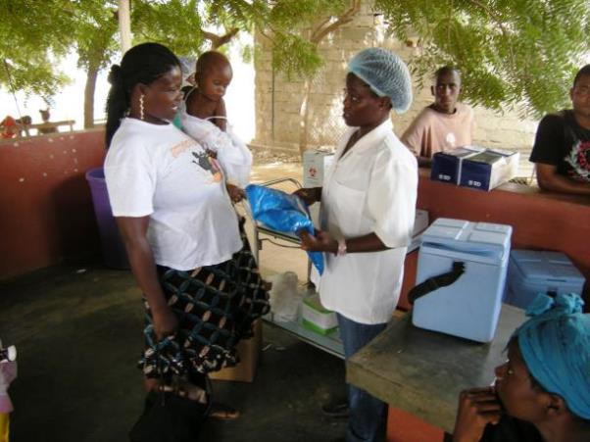
Mother receiving insecticide-treated net in Angola
Photo by: William Brieger/Jhpiego

Slide 111
ITNs
ITNs, specifically LLINs, are very effective.
Mosquitos generally bite at night, when people are asleep.
ITNs reduce human contact with mosquitoes by:
  Killing mosquitoes that land on the net
  Repelling them, thus driving them away from where people are sleeping

Slide 112
ITNs (continued)
Prevent physical contact with mosquitoes.
Kill or repel other insects:
  Lice
  Ticks
  Bedbugs

Slide 113
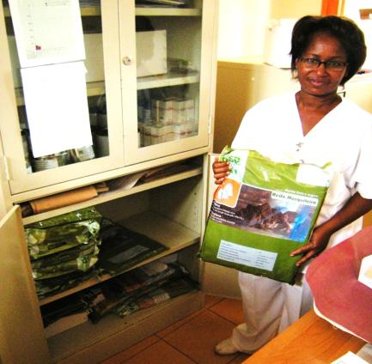
Antenatal care nurse with an insecticide-treated net in Mozambique
Photo by: William Brieger/Jhpiego

Slide 114
ITNs versus Untreated Nets
ITNs
Untreated Nets
Provide a high level of protection against malaria.
Kill or repel mosquitoes that touch the net.
Reduce number of mosquitoes inside and outside the net.
Kill other insects, such as lice and bedbugs.
Are safe for pregnant women, young children, and infants.
Provide some protection against malaria.
Do not kill or repel mosquitoes that touch the net.
Do not reduce the number of mosquitoes.
Do not kill other insects, such as lice and bedbugs.
Are safe for pregnant women, young children, and infants.

Slide 115
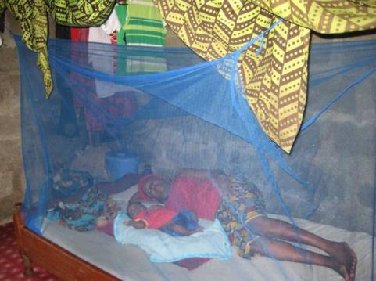
Mother and infant using a bed net in
Akwa Ibom State, Nigeria
Photo by: William Brieger/Jhpiego

Slide 116
Benefits of ITNs
Prevent mosquito bites.
Protect against malaria, resulting in less:
  Anemia (maternal and newborn)
  Premature and low-birthweight infants
  Risk of maternal and newborn death
Help people sleep better.
Promote growth and development of fetus and newborn.

Slide 117
Community Benefits of ITNs
Cost less than treating malaria.
Reduce the number of people getting sick (children
and adults).
Help children grow to be healthy and help working
adults remain productive.
Reduce number of deaths.

Slide 118
Where to Find ITNs
ANC clinics
General merchandise shops
Drug shops/pharmacies
Markets
Public and private health facilities
Community health workers
Nongovernmental organizations and community-based organizations

Slide 119
How to Use ITNs
Hang net above bed or sleeping mat.
Tuck edges under mattress or mat.
Use every night, all year long.
Use for everyone, if possible, but give priority to pregnant women, infants, and children.

Slide 120
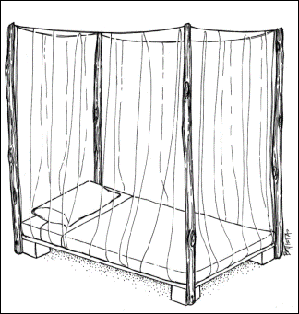
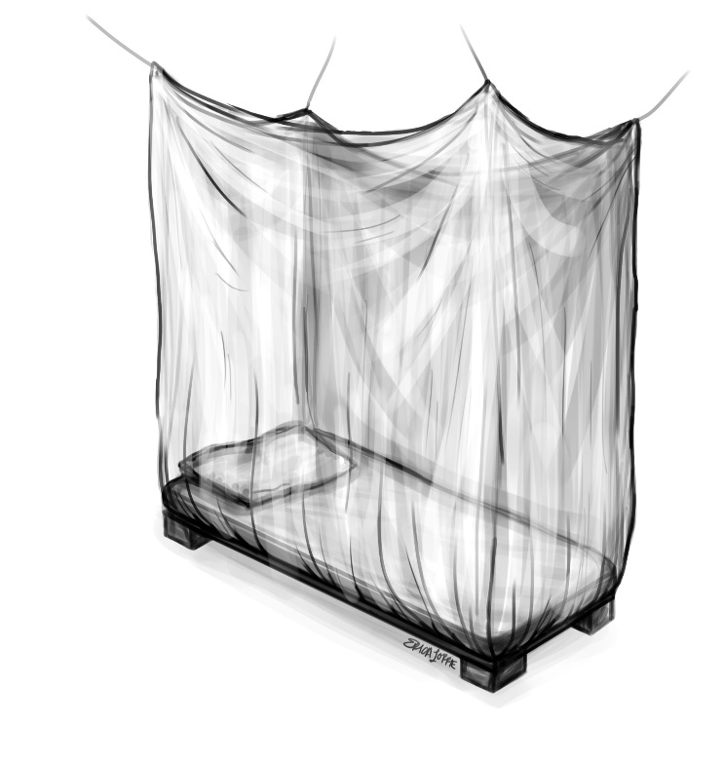
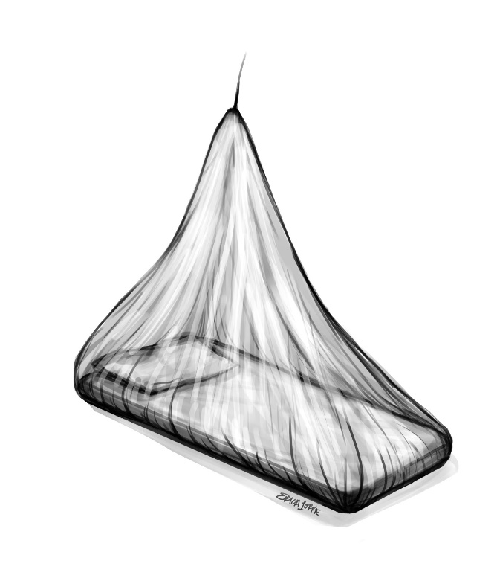
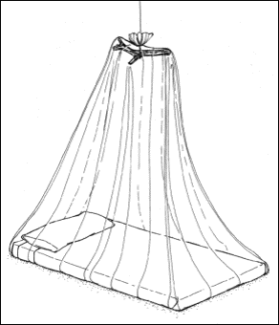
ITNs
ITN tucked under a bed
ITN tucked under a mat

Slide 121
Caring for ITNs
Handle net gently to avoid tears.
Tie net up during day to avoid damage.
Inspect regularly for holes and repair any holes found.
Retreat nets regularly if they are not long-lasting so they will stay effective (retreating methods available on WHO website).
Keep away from smoke, fire, and direct sunlight.
The demand for LLINs has increased rapidly, from 5.6 million in 2004 to 145 million in 2010 (in sub-Saharan Africa).

Slide 122
LLINs
A pre-treated, ready-to-use net that lasts between 3 and 5 years (depending on type) and does not require retreatment during that time
Compared to regular ITNs, LLINs:
  Usually have a one-time cost.
  Do not require additional treatments for 3 to 5 years.
  Save money because there are fewer additional costs associated with retreatment, retreatment campaigns, and additional insecticides.

Slide 123
LLINs (continued)
Some studies have shown that for many reasons, LLINs may not last for the intended 3 to 5 years.
WHO thus recommends that each country conduct its own study to assess net attrition and physical integrity to better plan campaigns to resupply nets (WHO 2013b).

Slide 124
Module Section 3.2
IPTp-SP

Slide 125
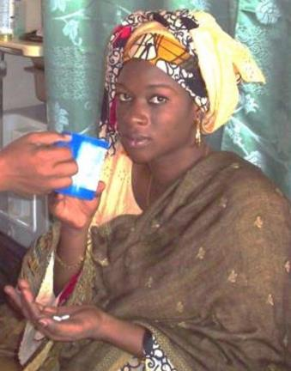
ANC provision of IPTp-SP by DOT in Senegal
Photo by: Karim Seck/Jhpiego

Slide 126
IPTp-SP
IPTp-SP is based on the assumption that every pregnant woman living in an area of high malaria transmission has malaria parasites in her blood or placenta, whether or not she has symptoms of malaria.
Although a pregnant woman with malaria might not have symptoms, malaria could nevertheless affect her and her fetus.
Placental infection can begin by the end of the first trimester.
Preventing parasites from attacking the placenta helps the fetus develop normally and prevents low birthweight.

Slide 127
Expected Benefits of IPTp-SP per WHO Policy Brief on IPTp-SP (2013c)
IPTp-SP prevents the adverse consequences of malaria on maternal and fetal outcomes, such as placental infection, clinical malaria, maternal anemia, fetal anemia, low birthweight, and newborn mortality.
IPTp-SP has recently been shown to be highly cost-effective for prevention of maternal malaria and reduction of newborn mortality in areas with moderate or high malaria transmission.
Despite the spread of SP resistance, IPTp-SP continues to provide significant benefit, resulting in protection against both newborn mortality (protective efficacy: 18%) and low birthweight (21% reduction) under routine program conditions.

Slide 128
Expected Benefits of IPTp-SP (continued)
A recent study by Chico et al. (2017) found that pregnant women who received two or more doses of IPTp-SP were protected not only from adverse outcomes related to malaria but also some sexually transmitted/reproductive tract infections.

Slide 129
SP Resistance and IPTp-SP
Evidence shows that SP prevents consequences of malaria in pregnant women who have already had a number of malaria infections and thus a certain level of immunity. It is thought that SP primarily works through a prophylactic effect.
Recent evidence also demonstrates that SP is associated with higher mean birthweight and fewer low-birthweight births across a wide range of SP resistance levels. Even in areas where a high proportion of P. falciparum parasites carry these quintuple mutations, IPTp-SP remains effective in preventing the adverse consequences of malaria on maternal and fetal outcomes (WHO 2013c).

Slide 130
Past Recommendations for IPTp-SP: Dose and Timing (WHO 2004)
PREVIOUSLY
All pregnant women were given at least two doses of SP during focused ANC visits, at least 1 month apart.
The first dose was given no earlier than 16 weeks of pregnancy (or quickening).
The recommended dose was and remains three tablets via directly observed therapy.

Slide 131
Current Recommendations for IPT-SP: Dose and Timing (WHO 2013c)
CURRENTLY
As early as possible during the second trimester, all pregnant women are given IPTp-SP (500 mg/25 mg), three tablets at one time via directly observed therapy.
IPTp-SP should be given at each scheduled contact, at least 1 month apart, and only after the first trimester.
The last dose of IPTp-SP can be administered until the time of delivery without safety concerns.
SP can be given on an empty stomach or with food.

Slide 132
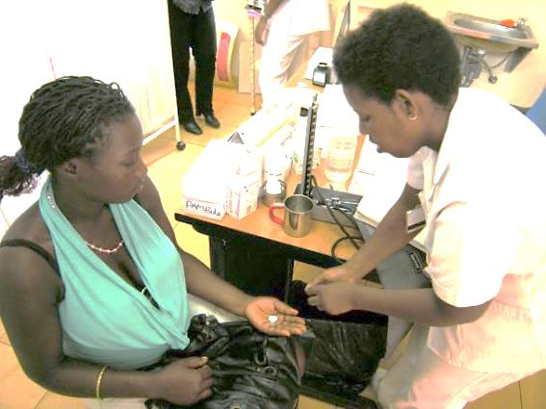
Giving IPTp-SP in Mozambique
Photo by: William Brieger/Jhpiego

Slide 133
Before Giving IPTp-SP
Ensure that the woman is in the second trimester of pregnancy
(at least 13 weeks pregnant).
Inquire about her use of SP within the last month (4 weeks).
Ensure that she is not on co-trimoxazole or taking other sulfa drugs.
Counsel that if she takes high doses of folic acid* (≥ 5 mg), she should suspend the folic acid for at least 2 weeks after each SP dose.
Inquire about allergic reactions to SP or other sulfa drugs (especially severe rashes).
Explain what you will do and address the woman’s questions.
Provide a cup and clean water.
* WHO recommends folic acid at a dose of 0.4 mg daily during pregnancy.

Slide 134
Instructions for Giving IPTp-SP
Directly observe the woman swallow three tablets of SP.
Record the SP dose on ANC and clinic cards as directly observed therapy.
Record the SP dose (IPTp-SP1, IPTp-SP2, IPTp-SP3, etc.) in the appropriate registers.
Advise the woman to return:
  For her next scheduled contact
  If she has signs of malaria
  If she has other danger signs
Reinforce the importance of using ITNs year-round.

Slide 135
IPTp: Contraindications to SP
Do not give SP during the first trimester. Be sure the
woman is at least 13 weeks pregnant.
Do not give SP to women with a reported allergy to SP or other sulfa drugs. Ask about sulfa drug allergies before giving SP.
Do not give SP to women taking co-trimoxazole or other sulfa-containing drugs. Ask about use of these medicines before giving SP.
Do not give SP more frequently than monthly. Be sure at least 1 month has passed since the last dose of SP.

Slide 136
IPTp-SP and Folic Acid
WHO recommends folic acid at a dose of 0.4 mg daily
during pregnancy (WHO 2013c).
Some evidence suggests that high doses (≥ 5 mg) of folate supplementation may reduce the effectiveness of SP for treatment of malaria (Ouma et al. 2006; WHO 2013c).
Use of recommended folic acid doses (0.4 mg) does not seem to reduce SP effectiveness.
If folic acid doses ≥ 5 mg are used, instruct pregnant women not to take folic acid for at least 2 weeks (14 days) after receiving SP.
Providers should understand and follow local protocols.

Slide 137
Determining Gestational Age
The recent WHO policy on administration of IPTp-SP
at 13 weeks of pregnancy may present a challenge to providers who are not accustomed to confirming early second-trimester gestation. The following information can serve as a review.

Slide 138
Determining Gestational Age (continued)
Take a history.
  Ask about regularity of menstrual periods, current breastfeeding, and current or past use of contraception.
  Ask about the date of the first day of the last menstrual period and use a pregnancy wheel or calendar to determine weeks of pregnancy.
  Ask whether quickening has occurred. If it has, the woman is probably in the second trimester. If she has not noted fetal movement, she is still a candidate for IPTp-SP, if other findings confirm that she is at least 13 weeks pregnant.
  Information obtained from the history must be correlated with findings from the physical exam.

Slide 139
Determining Gestational Age (continued)
Perform an abdominal exam.
  In the first trimester, the uterus grows from the size of a lemon to the size of a large orange and cannot be palpated abdominally above the symphysis pubis.
  In the second trimester, the uterus grows to the size of a large mango or grapefruit and can be palpated abdominally about three fingerbreadths above the symphysis pubis.
  To palpate the uterus, make sure the woman has emptied her bladder.
  Explain what will be done (and why) before conducting the exam.

Slide 140
Determining Gestational Age (continued)
  Ask her to lie on her back with support under her head, bend her knees, and keep her feet flat on the bed or exam table.
  Using a firm but gentle touch, place fingers on the pubic bone and walk them up the center of the abdomen until the top of her uterus (fundus) is palpated; it will feel like a hard ball.
  A uterine fundus palpated about three fingerbreadths above the pubic bone is compatible with pregnancy in the second trimester.

Slide 141
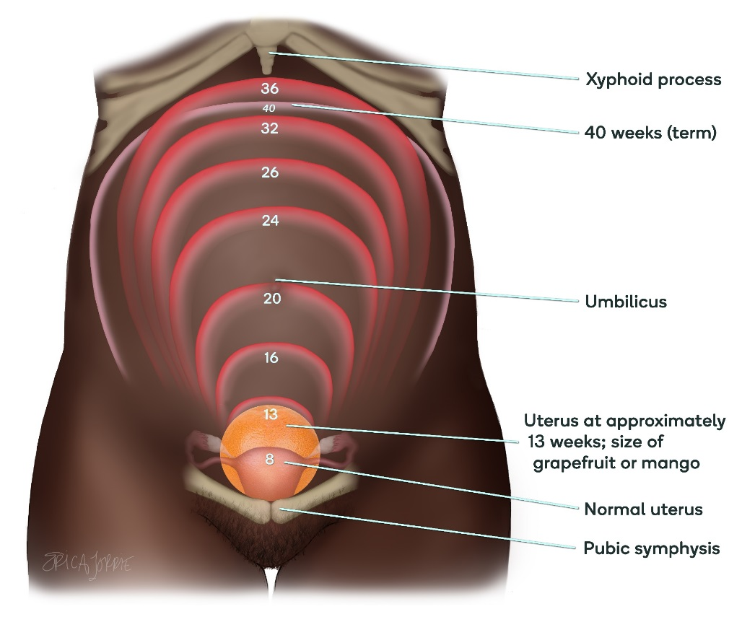
Determining Gestational Age (continued)
Uterine size at 13 weeks
on abdominal palpation
(about two to three
fingerbreadths above the
symphysis pubis)

Slide 142
Determining Gestational Age (continued)
Use other means of determining gestational age early
in pregnancy.
  Pregnancy tests, if available and affordable, can confirm pregnancy and be correlated with information from the history and physical exam.
  Ultrasound can be superior to dating by last menstrual period or physical examination, depending on clinical circumstances, but dating precision decreases with gestational age. WHO now recommends one obstetric ultrasound scan before 24 weeks gestation to estimate gestational age and to identify multiple pregnancies and fetal anomalies.

Slide 143
Module Section 3.3
Health Education for Additional Prevention Methods

Slide 144
IRS
The main purpose is to lower malaria transmission by reducing survival of mosquitoes entering houses or
sleeping areas.
IRS is an effective intervention when the following conditions
are met:
  Adequate commitment and social acceptance
  Enough health system capacity to deliver quality, well-timed coverage to at least 80% of dwellings
  Credible information about local vectors, especially their insecticide susceptibility, as well as indoor versus outdoor feeding and resting behaviors
Providers should keep up to date about local IRS programs
in their areas and educate clients accordingly.

Slide 145
More Ways to Prevent Malaria
Cover doors and windows with wire or nylon mesh/nets
to prevent mosquitoes from entering the house.
Avoid going outside after dark. When out in evenings:
  Wear protective clothing covering arms and legs.
  Apply chemical mosquito repellent cream on exposed skin surfaces.
  Use mosquito coils that release smoke. The smoke keeps mosquitoes away or kills them when they fly through it.
Spray rooms with insecticide before going to bed.
  This is only effective for a few hours, so spray in combination with other measures, such as screening doors and windows.
Physically kill mosquitoes indoors by swatting them.

Slide 146
Summary: Malaria Prevention
There are many ways of preventing bites and reducing mosquito
breeding sites.
Sleep inside ITNs (with edges tucked under mat or bedding). Where available, LLINs are preferable because they last longer and do not
require continuous retreatment.
Use of IPTp-SP prevents parasites from attacking the placenta.
IPTp-SP helps prevent malaria and reduces the incidence of maternal anemia, spontaneous abortions, preterm birth, stillbirth, and low birthweight.
IRS programs can be effective in reducing the number of mosquitoes that transmit malaria. They are not a replacement for ITNs and IPTp-SP, but they support and enhance these efforts.

Slide 147
Prevention and Control of Malaria in Pregnancy
Module 4: Diagnosis and Treatment of Malaria

Slide 148
Malaria Diagnosis and Treatment: Module 4 Objectives
Explain why self-diagnosis and treatment may lead to treatment failure
or recurring infection.
Describe the types of diagnostic tests available for malaria and their advantages and disadvantages.
Identify other causes of fever during pregnancy.
List the signs and symptoms of uncomplicated and severe MIP.
Describe the treatment for uncomplicated MIP.
Explain the steps to appropriately refer a pregnant woman who has
severe malaria.

Slide 149
Malaria Diagnosis
Usually based on the patient’s signs and symptoms, clinical history, physical examination, and laboratory confirmation of the malaria parasite, if available
Prompt and accurate diagnosis leads to:
  Improved differential diagnosis of febrile illness
  Improved management of nonmalarial illness
  Effective case management of malaria

Slide 150
Self-Diagnosis
Clients who experience symptoms often rely on
self-diagnosis and treatment.
Because symptoms are similar to those of several other common ailments, misdiagnosis is possible.
Prevalence of asymptomatic infections makes
self-diagnosis even more complex.
Clients might take the wrong medicines, or might take the right medicines but not in the proper dosage or
for the recommended duration.

Slide 151
Self-Diagnosis and Treatment
If a client has self-treated and presents with malaria symptoms, or she reports that symptoms have worsened or recurred, it is possible that she:
  Has self-treated with the wrong drug or dosage.
  Has not completed the treatment.
  Has been given incorrect treatment instructions (or did not understand instructions).
  Has received a poor-quality or counterfeit drug (this can happen even at health facilities).
  Does not have malaria.
  Often, clients can purchase drugs—without a prescription
  or verification of diagnosis—at pharmacies, local shops,
  roadside kiosks, and other easily accessible locations.

Slide 152
Module Section 4.1
Diagnostic Tools and Testing

Slide 153
Diagnostic Testing: Advantages
Parasitological diagnosis has several major advantages, including:
  Prevention of wastage of drugs through unnecessary treatment, resulting in cost savings
  Improvement of care in parasite-positive patients due to greater certainty of malaria diagnosis
  Prevention of unnecessary exposure to malaria drugs
  Confirmation of treatment failure

Slide 154
Methods: Diagnostic Testing
The two methods of diagnostic testing for malaria are light microscopy and rapid diagnostic testing.
After a woman presents with malaria symptoms and is tested, results should be available within a short time
(less than 2 hours).
If diagnostic testing is not possible, women must be treated on the basis of clinical diagnosis, but every effort should be made to conduct confirmatory testing.
Source: WHO 2015d

Slide 155
Diagnostic Testing: Microscopy
Microscopic examination:
Remains the “gold standard” for laboratory confirmation of malaria.
Involves examination of the client’s blood, spread out as a thick or thin blood smear on a microscopic slide.
Confirms the presence of malaria parasites and therefore the diagnosis of malaria.
Is also useful when a client has vague symptoms.

Slide 156
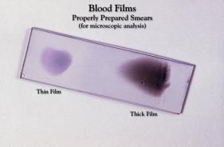
Thin Film
Is often preferred for routine examination of parasites.
Makes organisms easier to see so the type of parasite can be identified.
Is inadequate for detecting low parasite density.
This Giemsa-stained slide depicts an example of properly prepared thick and thin film blood
smears to be examined.
Source: Courtesy of CDC Public Health Image Library: http://phil.cdc.gov/phil/home.asp

Slide 157
Thick Film
Concentrates the layers of red blood cells on the slide, using about two to three times more blood
than the thin film.
Is better than the thin film in detecting low levels of parasites, and estimating parasite density and reappearance of circulating parasites during relapses.
Requires experienced technician because scanning for parasites among white blood cells and platelets can
be difficult.

Slide 158
Rapid Diagnostic Testing
Developed to provide quick, accurate, and accessible malaria diagnosis without the need for laboratory facilities.
Successful rapid diagnostic testing programs require:
  A cool chain for transport and storage
  Training for providers
  A clear policy on actions to take based on test results

Slide 159
Maintaining a Cool Chain
Storage between 2°C and 30°C is recommended by
rapid diagnostic test (RDT) manufacturers.
Expiry dates are generally set according to these conditions.
If storage temperatures exceed the recommended limits, it is likely that the shelf life of the RDTs will be reduced and sensitivity lost before the expiration date.

Slide 160
Maintaining a Cool Chain (continued)
The cool chain starts before shipping from the manufacturer.
  The shipper or air carrier is notified of temperature storage requirements, which are clearly marked on cartons and documents.
Ground transportation:
  Attention must be given to outside temperatures while the vehicle is moving and parked during all stages of delivery.
Storage:
  Storage of RDTs at any stage before they reach the final destination should conform to manufacturers’specifications, which are usually ≤ 30°C.

Slide 161
Indications for Diagnostic Testing
For pregnant women, a parasitological diagnosis is recommended before starting treatment.
  Those who live in or have come from areas of unstable transmission are the most likely candidates for severe malaria, which can be
  life-threatening.
Diagnostic testing is also used as a test of cure in clients who have been treated for malaria but still have symptoms.
  If treatment was adequate, clients may have been reinfected or have another problem causing similar symptoms.
  Remember that counterfeit or poor-quality drugs may also cause treatment failure.

Slide 162
Module Section 4.2
Clinical Diagnosis

Slide 163
Types of Malaria
Uncomplicated:
  Most common
Severe:
  Life-threatening; can affect the brain
  Pregnant women more likely to get severe malaria than non-pregnant women

Slide 164
Clinical Signs and Symptoms
A diagnosis of malaria is based on the patient's symptoms and on physical findings at examination.
First symptoms of malaria and physical findings often are not specific and are common to other diseases.

Slide 165
Uncomplicated Malaria: Signs and Symptoms
The signs and symptoms of malaria are nonspecific.
Malaria is suspected clinically primarily on the basis of fever or a history of fever (≥ 37.5°C axillary); anemia may also be present.
There is no combination of signs or symptoms that reliably distinguishes malaria from other causes of fever. A diagnosis based only on clinical features has very low specificity and can result in overtreatment.

Slide 166
Severe Malaria: Diagnosis
In severe malaria (caused by Plasmodium falciparum), clinical findings are more striking and may increase the suspicion of malaria.
Thus, in most cases, the early clinical findings in malaria are not typical and must be confirmed by a laboratory test.

Slide 167
Severe Malaria: Signs and Symptoms
One or more of the following clinical features in the presence of malaria parasitemia or positive RDT:
Impaired consciousness/coma
Prostration/generalized weakness
Multiple convulsions (more than two in 24 hours)
Deep breathing/respiratory distress
Acute pulmonary edema
Shock (systolic blood pressure < 80 mmHg)
Acute kidney injury
Clinical jaundice, evidence of other vital organ dysfunction
Significant bleeding

Slide 168
Pre-Referral Treatment for Severe Malaria in Pregnant Women
Administer loading dose of appropriate antimalarial drug and refer the woman
immediately
if you suspect anything other than uncomplicated malaria.

Slide 169
Recommendations for Clinical Diagnosis
WHO’s 2015 recommendations for clinical diagnosis/suspicion of uncomplicated malaria in different epidemiological settings:
In malaria-endemic areas, malaria should be suspected in any patient presenting with a history of fever or temperature ≥ 37.5°C and no other obvious cause.
In settings where the incidence of malaria is very low, parasitological diagnosis of all cases of fever may result in considerable expenditure to detect only a few patients with malaria. Thus, patients should be identified who may have been exposed to malaria (e.g., have recently traveled to a malaria-endemic area without protective measures) and have fever or a history of fever with no other obvious cause before a parasitological test is conducted.

Slide 170
Recommendations for Clinical Diagnosis (continued)
Signs and symptoms of malaria are nonspecific.
Making a judgment or diagnosis based on clinical features alone has very low specificity, resulting in overtreatment for many.
Other possible causes of fever and the need for alternative or additional treatment must be carefully considered.
In all settings, clinical suspicion of malaria should be confirmed with a parasitological diagnosis.
In settings where parasitological diagnosis is not possible, the decision to provide antimalarial treatment must be based on the prior probability of the illness being malaria.

Slide 171
Module Section 4.3
Caution: Presumptive Treatment

Slide 172
Definition: Presumptive Treatment (for Clients)
Patients who suffer from a fever without an obvious cause are presumed to have malaria and are treated for that disease, based only on clinical suspicion and without the benefit of laboratory confirmation.

Slide 173
Problems: Presumptive Treatment
In settings where parasitological diagnosis is not possible, a decision to provide antimalarial treatment must be based on the probability that the illness is malaria.
Presumptive treatment can lead to incorrect diagnoses and unnecessary use of antimalarial drugs.
  Results in additional expense and increases the risk of selecting for drug-resistant parasites.
  For children and pregnant women, it may be the best option when diagnostic testing is not available.

Slide 174
Fever during Pregnancy
Temperature ≥ 37.5°C axillary
May be caused by malaria or:
  Bladder or kidney infection
  Pneumonia
  Typhoid, dengue fever, or yellow fever
  Uterine infection
  Viral illnesses
Careful history and a physical exam are needed to rule out other causes.

Slide 175
Fever during Pregnancy (continued)
Ask the woman about or examine her for:
Type, duration, and degree of fever
Whether she has or has had:
  Chills or rigors
  Episodes of a spiking fever
  Fits or convulsions
Temperature, blood pressure, pulse, and respiration

Slide 176
Fever during Pregnancy: Other Things to Ask About
Signs of severe malaria
Signs of other infections:
  Chest pain/difficulty breathing
  Foul-smelling, watery vaginal discharge
  Tender/painful uterus or abdomen
  Urinary frequency/urgency/pain on urination/flank pain
Any fluid leaking from vagina/rupture of membranes
Headache
Muscle/joint pain
Dry or productive cough
Other danger signs

Slide 177
Recognizing Malaria in Pregnant Women
Uncomplicated Malaria
Severe Malaria
Signs and symptoms are nonspecific but can include fever ≥ 37.5°C axillary, history of fever, and/or presence of anemia.
One or more of the following along with the presence of malaria parasitemia:
Impaired consciousness/coma
Prostration/generalized weakness
Multiple convulsions (more than two in 24 hours)
Deep breathing/respiratory distress
Acute pulmonary edema
Shock (systolic blood pressure < 80 mmHg)
Acute kidney injury
Clinical jaundice, evidence of other vital organ dysfunction
Significant bleeding

Slide 178
Signs and Symptoms of Uncomplicated and Severe Malaria

Slide 179
Module Section 4.4
Case Management of Malaria during Pregnancy

Slide 180
Case Management Goals: Malaria during Pregnancy
Despite preventive measures, some pregnant women
will still become infected with malaria.
The goal of malaria treatment during pregnancy is to completely eliminate the infection because having any parasites in her blood can affect the mother and her fetus.

Slide 181
Case Management Goals: Malaria during Pregnancy (continued)
Determine whether malaria is uncomplicated or
severe:
  Uncomplicated: Manage according to the case management job aid.
  Severe: After administering loading dose of appropriate antimalarial drug, refer immediately to higher level of care.

Slide 182
Case Management: Drugs
Selection of treatment is based on:
  The trimester of pregnancy
  Available drugs
  Approved drugs for malaria treatment in accordance with national guidelines

Slide 183
Case Management: Combination Therapy
Plasmodium falciparum has become resistant to
single-drug therapy, resulting in ineffective treatment
and increased morbidity and mortality.
WHO now recommends that countries use a combination of drugs to fight malaria.
Drug resistance is far less likely with combination
therapy than with single-drug treatments.

Slide 184
ACTs: Types of Combination Therapy
Artemisinin-based combination therapies (ACTs):
The simultaneous use of a drug that includes a derivative of artemisinin along with another antimalarial drug
Currently the most effective treatment for malaria
Should be the first-line treatment in the second and third trimesters

Slide 185
Module Section 4.5
Treatment for Uncomplicated Malaria

Slide 186
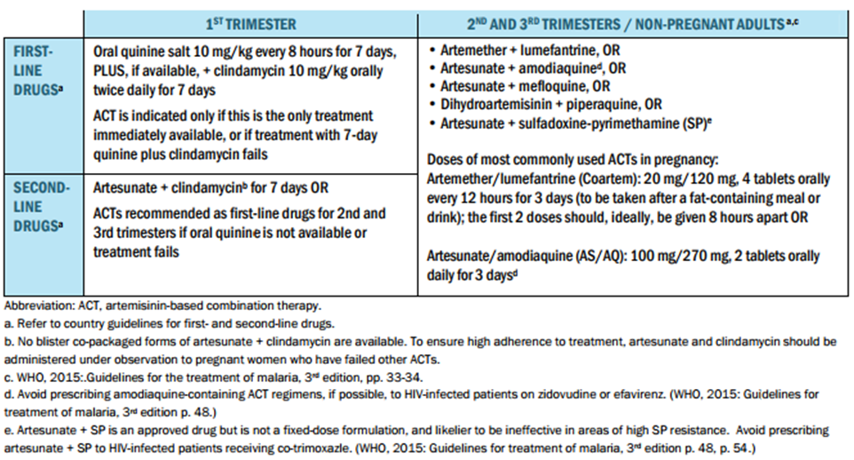
WHO 2015 Recommendations for ACT in Pregnancy

Slide 187
Treating Uncomplicated Malaria
Observe the client taking the first dose of her antimalarial
drugs (directly observed therapy) and record the dosages.
Advise the client to:
  Complete the course of drugs.
  Return in 48 hours for follow-up, or sooner if condition worsens.
  Consume iron-rich foods.
  Use ITNs and other preventive measures.
Follow country guidelines with regard to use of IPTp-SP and iron/folic acid during and after treatment of malaria.

Slide 188
Treating Uncomplicated Malaria (continued)
Provide first-line antimalarial drugs.
  Refer to case management job aid.
Manage fever ≥ 38°C axillary.
  Tepid sponging; paracetamol 500 mg, two tablets every
  6 hours as needed
Diagnose and treat anemia.
Provide fluids.

Slide 189
Module Section 4.6
Management of Severe Malaria

Slide 190
Severe Malaria: Convulsions or Fits
If a pregnant woman presents with convulsions, determine whether they are due to malaria or eclampsia.
Gather information from the following chart to determine the cause of convulsions or fits.

Slide 191
Determining Causes of Convulsions
Signs/Symptoms | Severe Malaria | Eclampsia
Recent history of fever, chills | Yes | No
Temperature | > 37.5° C | < 38° C
Blood pressure | Diastolic < 90 mmHg | Diastolic > 90 mmHg
Proteinuria | No | Yes
Enlarged spleen | Possibly | No
Jaundice | Yes | No

Slide 192
Other Considerations (CDC 2013)
If eclampsia is suspected, stabilize and treat with
magnesium sulfate per national guidelines, then refer.
If severe malaria is suspected, stabilize and treat with appropriate antimalarial drug and diazepam, then refer.
Oral antimalarial drugs are not recommended for the initial treatment of severe malaria.
If severe malaria is strongly suspected but a laboratory diagnosis cannot be made, collect blood for diagnostic testing. Parenteral antimalarial drugs may be started.

Slide 193
Severe Malaria: Pre-Referral Treatment
(WHO 2015d)
In the case of antimalarial treatment for severe malaria, the main objective is to prevent death.
The risk of death from severe malaria is greatest in the
first 24 hours.
Delaying the start of appropriate antimalarial treatment can result in worsening of a woman’s condition or even death.
If possible, start treatment immediately by giving the pregnant woman a loading dose of a parenteral antimalarial before referral: parenteral artesunate, 2.4 mg/kg, IV bolus (“push”) or IM injection.

Slide 194
Stabilize Severe Malaria
Stabilize by providing a loading dose of the appropriate antimalarial drug and refer the woman
immediately
if she has any symptoms that suggest severe malaria.

Slide 195
Stabilization and Pre-Referral Treatment for Severe Malaria
To view the entire job aid for Treatment of Uncomplicated Malaria Among Women of Reproductive Age, please see the reference manual, Figure 11.

Slide 196
Referral Preparation
Explain the situation to the client and her family.
Give her pre-referral treatment, if possible.
Help arrange transport to a higher-level facility, if possible.
Accompany the woman during transport, if possible, and be sure to have sufficient medication available.
Record the referral information on the ANC card.

Slide 197
Referral Notes
Include the following in your referral note:
  Brief history of client’s condition
  Details of any treatment provided
  Reason for referral
  Any significant findings from history, physical exam, or
  lab tests
  Highlights of any important details of current pregnancy
  Copy of client’s ANC record, if possible
  Contact information in case the referral facility or provider has any questions
  Source: Adapted from WHO 2015d.

Slide 198
Recognizing and Reporting Potential Adverse Effects
Health care providers should understand the potential adverse effects of all medications they administer. This includes those used to treat MIP, although these drugs are generally well tolerated and have no or only mild side effects, if used as directed.
Women need to know about adverse effects that they might experience and what to do if they occur. Potential adverse effects are summarized in the next slide.

Slide 199
Recognizing and Reporting Potential Adverse Effects (continued)
Artemether/lumefantrine: Weakness,
headache, dizziness
Artesunate/amodiaquine: Weakness (mild or severe) headache or dizziness
Quinine: Buzzing or ringing in the ears or hypoglycemia (when given parenterally)
Artemisinin: Dizziness, headache, vomiting, diarrhea

Slide 200
Recognizing and Reporting Potential
Adverse Effects (continued)
Providers should be aware of the pharmacovigilance (drug safety) system in their countries, to which they
can report:
  Adverse effects
  Other concerns about the medications they administer

Slide 201
Summary: Malaria Diagnosis and Treatment
Diagnostic testing should be performed to
confirm malaria illness.
Uncomplicated malaria can be easily treated if it is
recognized early, but it is very important to finish the course of treatment to be effective.
Because severe malaria requires specialized management, women with severe malaria should be given a loading dose of the appropriate antimalarial drug and referred immediately to avoid complications and death.

Slide 202
Module Section 4.7
Health Education

Slide 203
Keeping Up to Date
This malaria workshop and training materials should bring participants up to date on current policies and practices.
Malaria control is a dynamic field with new discoveries in the area of medicines, insecticides, and other interventions.
To maintain best practices, health workers need to update themselves through self-learning.

Slide 204
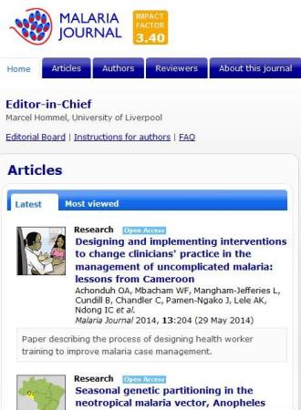
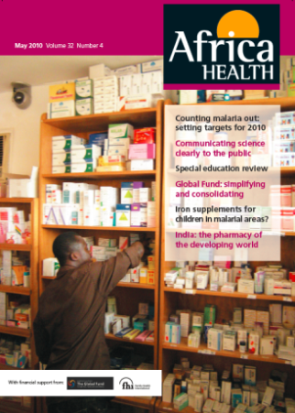
Free Journals/Magazines

Slide 205
The Internet: Crucial for Continued Self-Learning
Free online journals
  Africa Health: http://www.africa-health.com/
  Malaria Journal: http://www.malariajournal.com/
Twitter
  If you have a twitter account, search for the latest information using: #malaria
Listserv
  Sign up for malaria mailings: http://knowledge-gateway.org/malaria

Slide 206
References and Resources
For all references, see reference manual.

